Slide 1
Coal Patch Towns of Pennsylvania’s Bituminous Region
Dr. John Enman

Slide 2
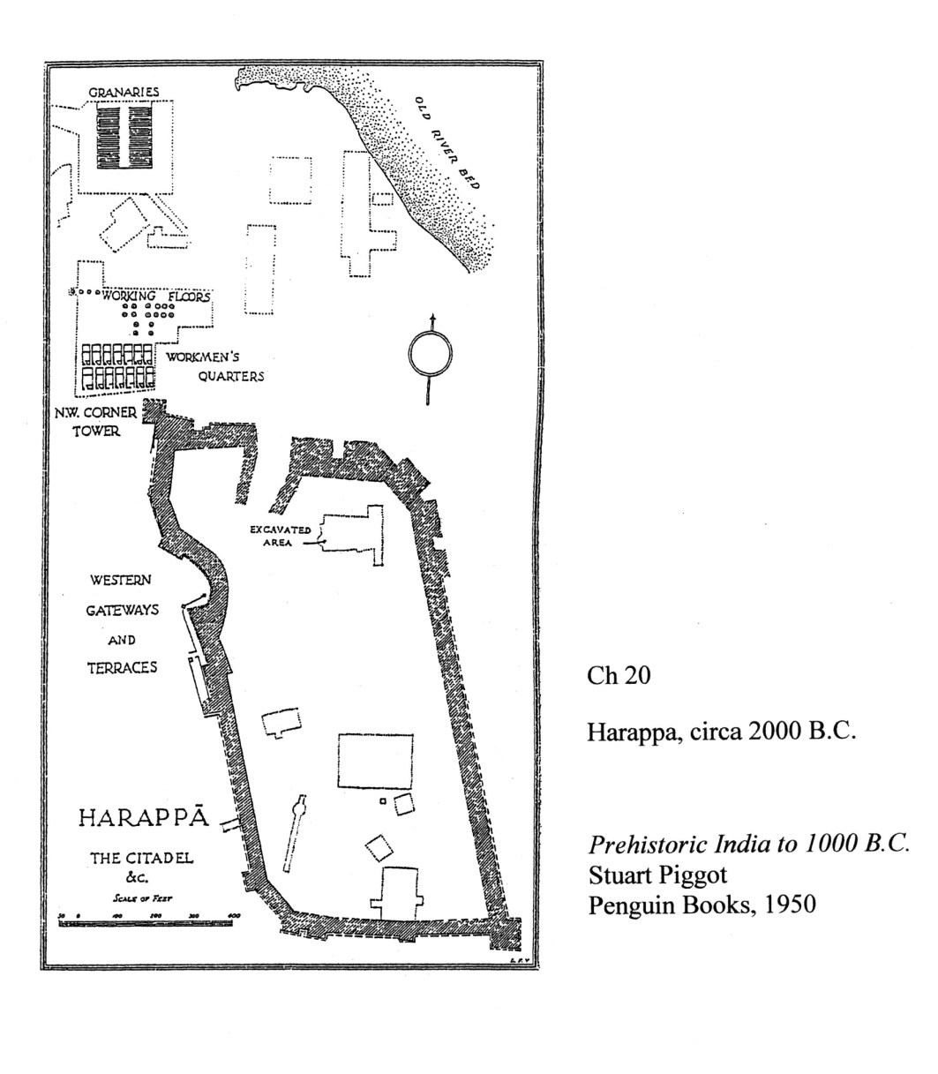
Coal Patch Towns
A
Harappa

Slide 3
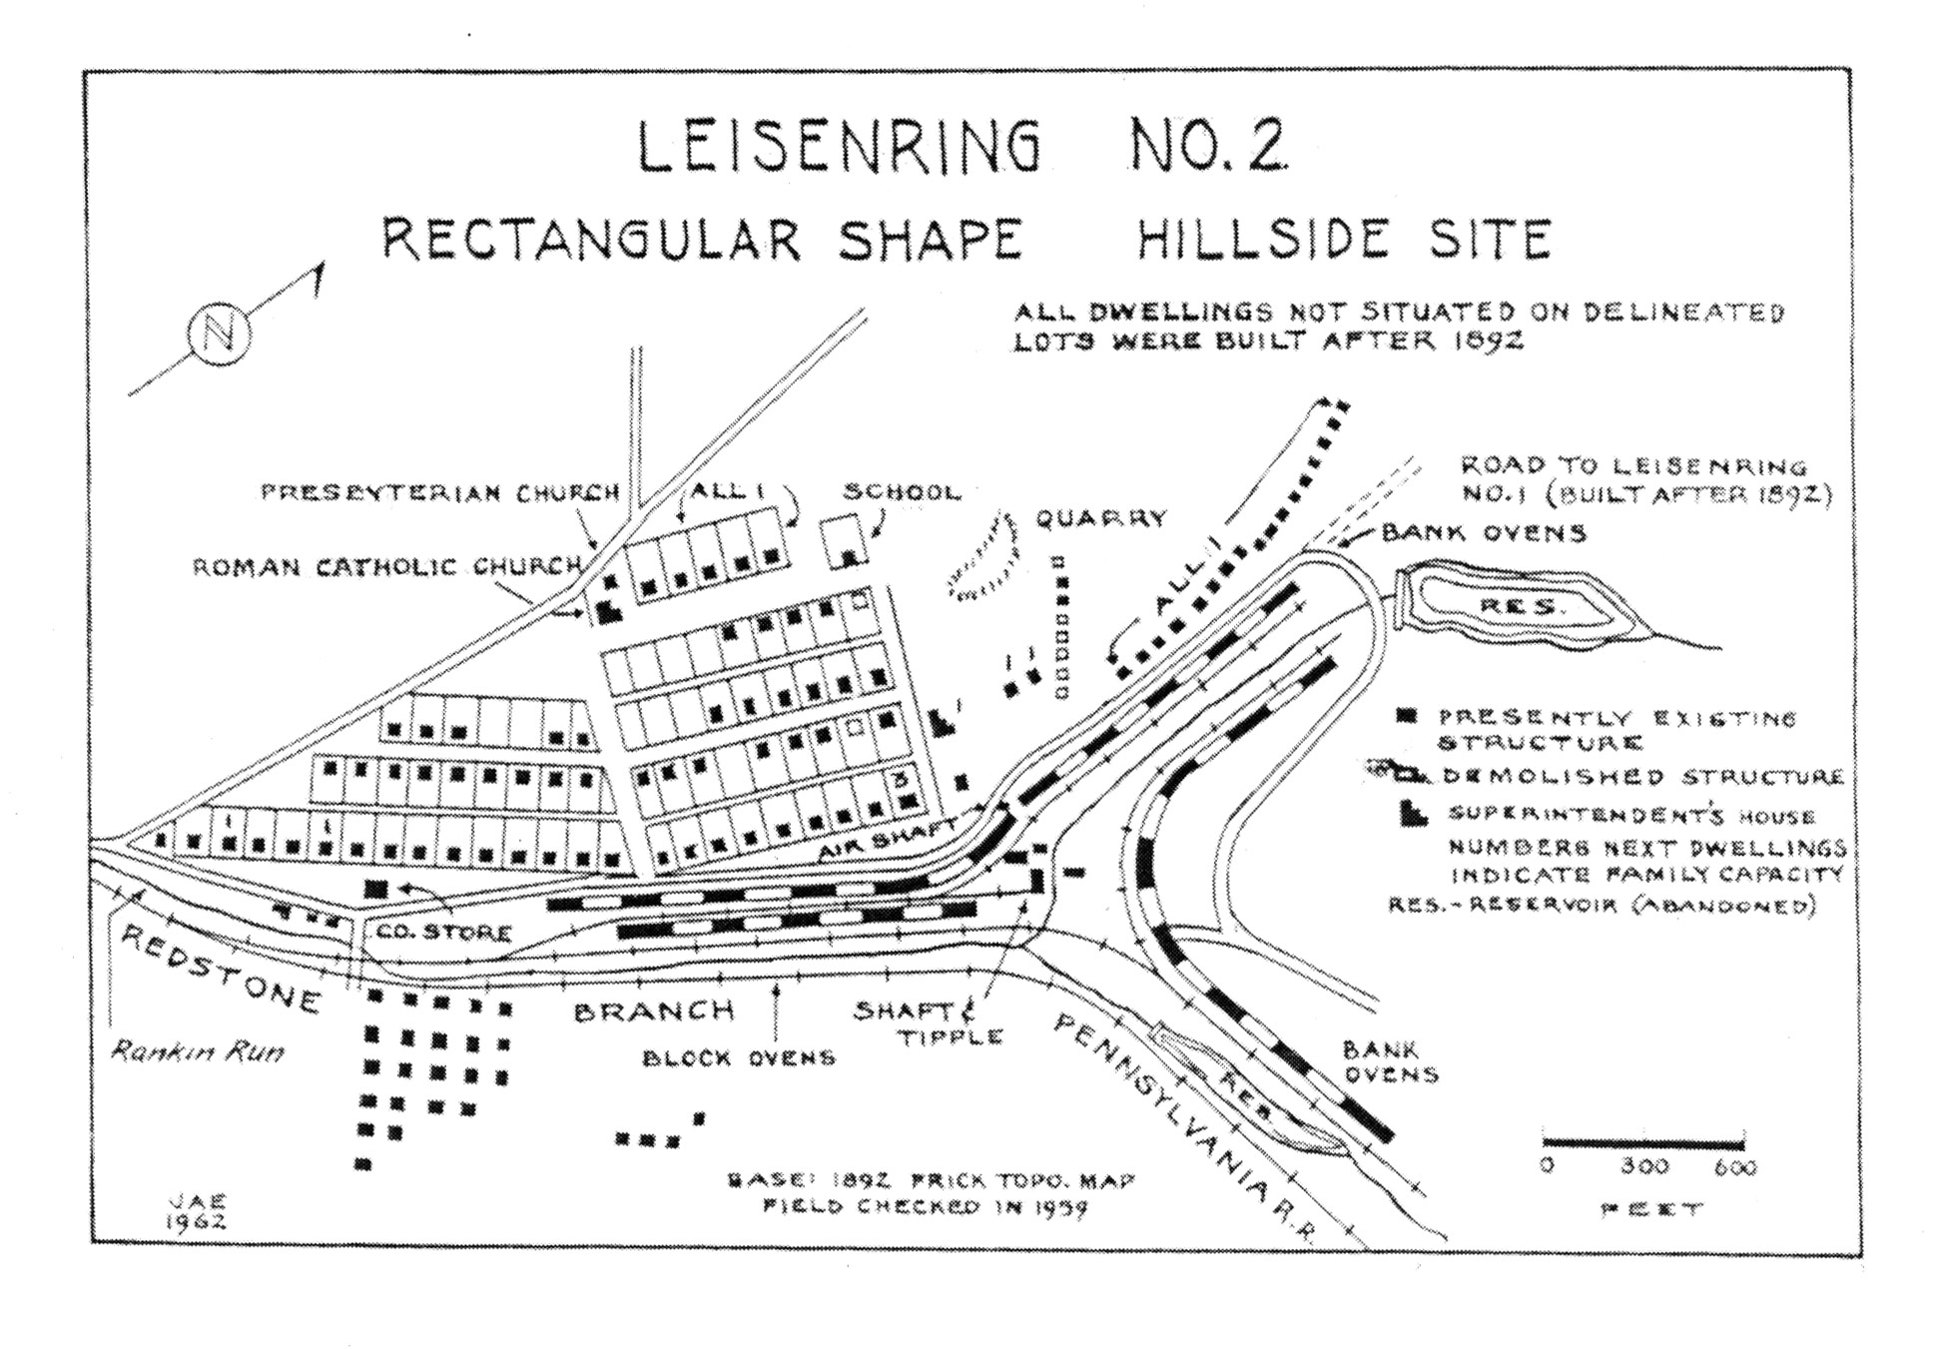
Coal Patch Towns
V
Plat, Leisenring #2

Slide 4
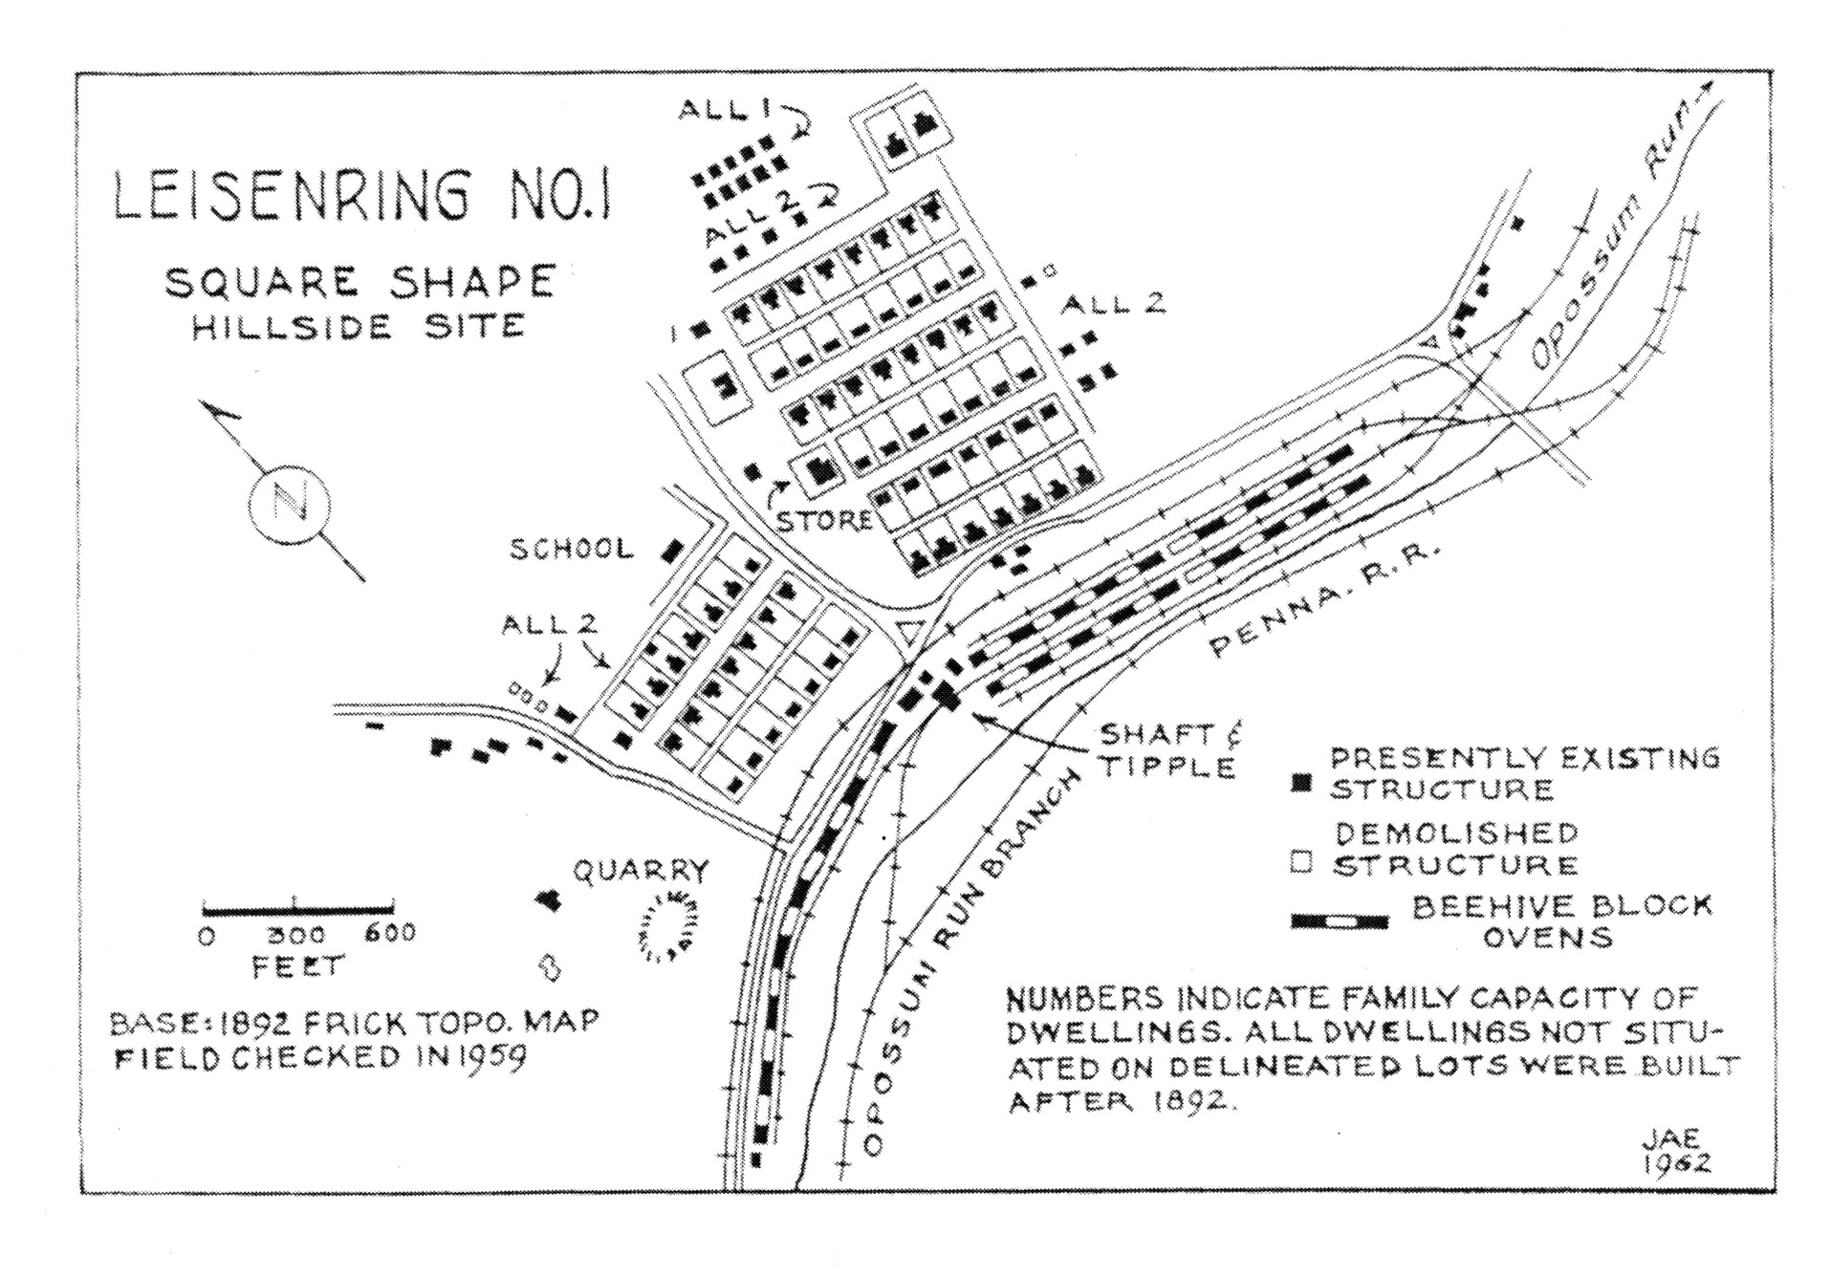
Coal Patch Towns
U
Plat
Leisenring #1

Slide 5
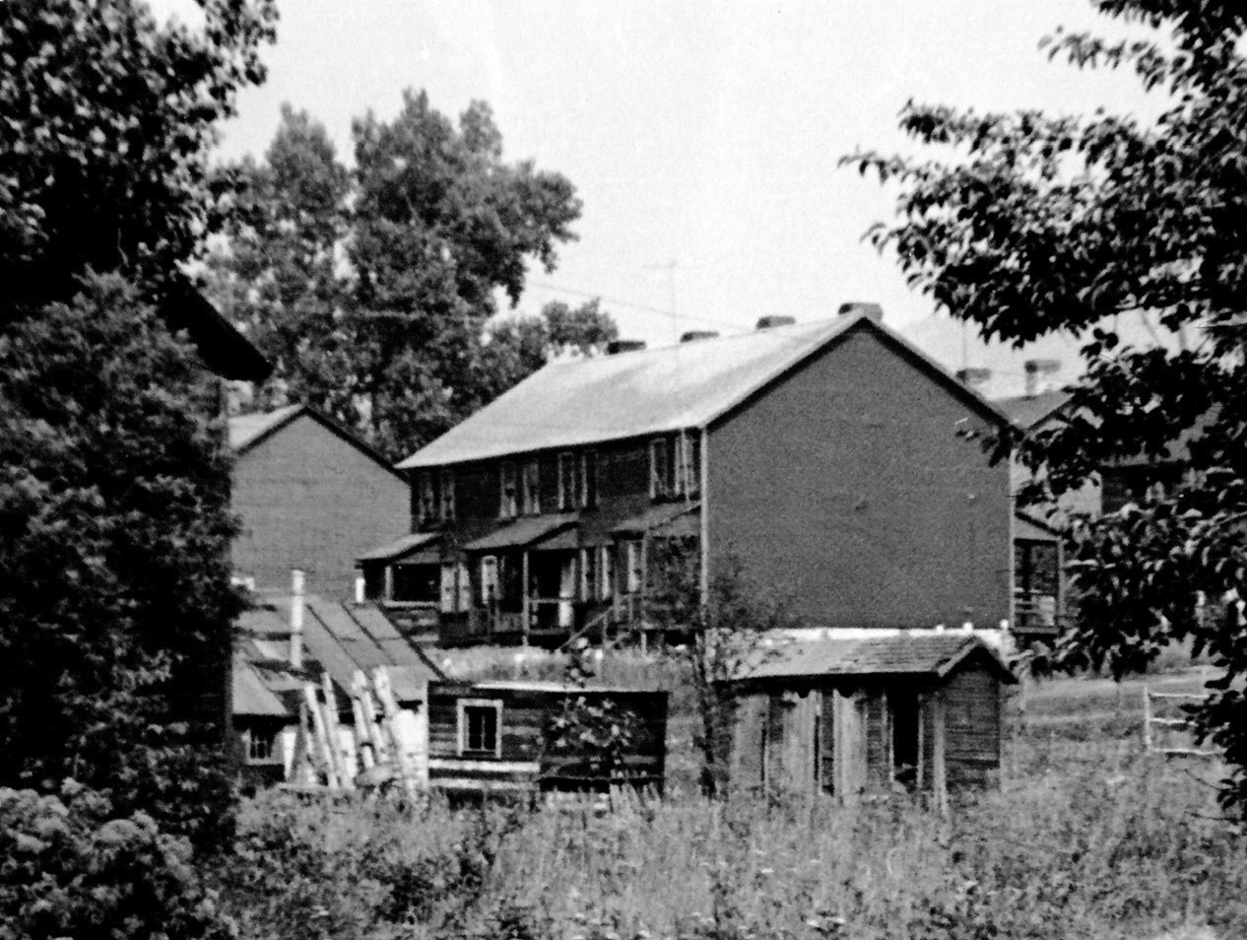
Coal Patch Towns
E
4 Family Linear
Wynn

Slide 6
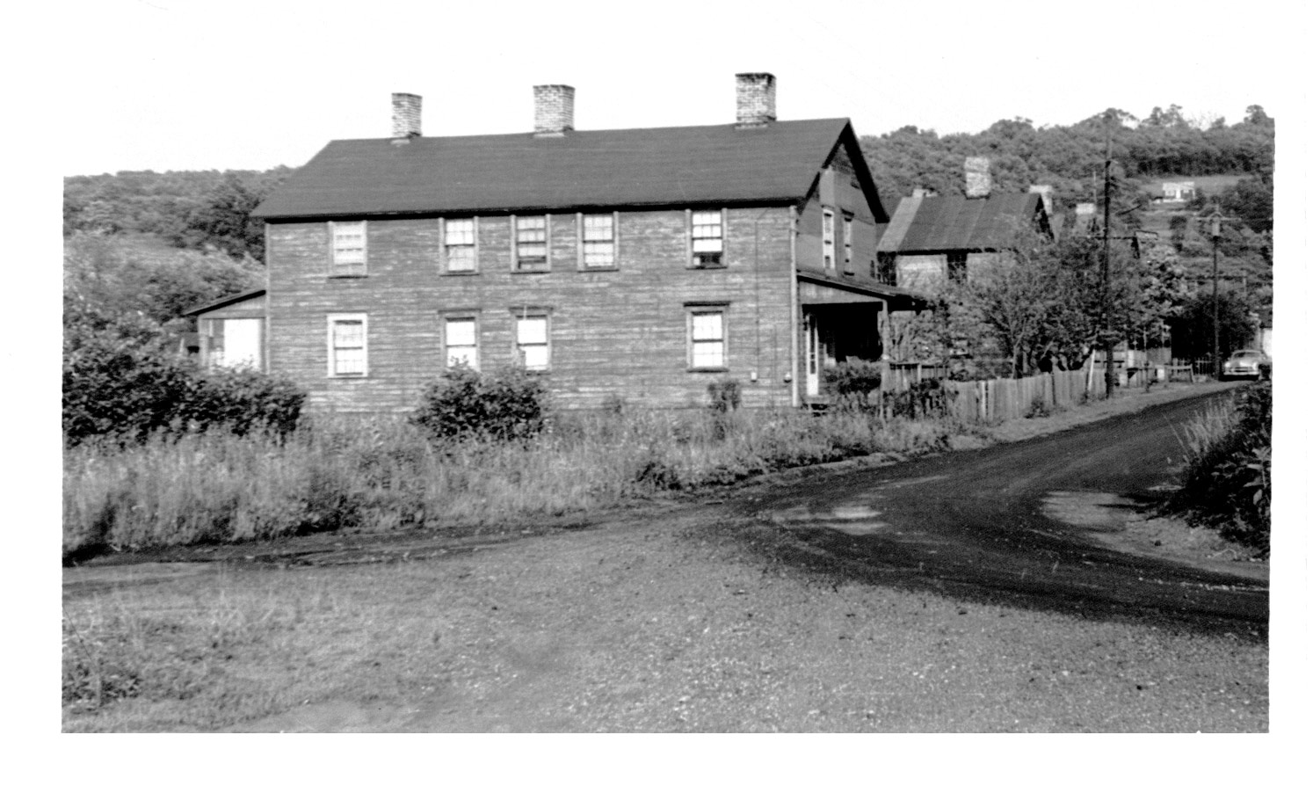
Coal Patch Towns
C
4 Family Rectangular
Mt. Braddock

Slide 7
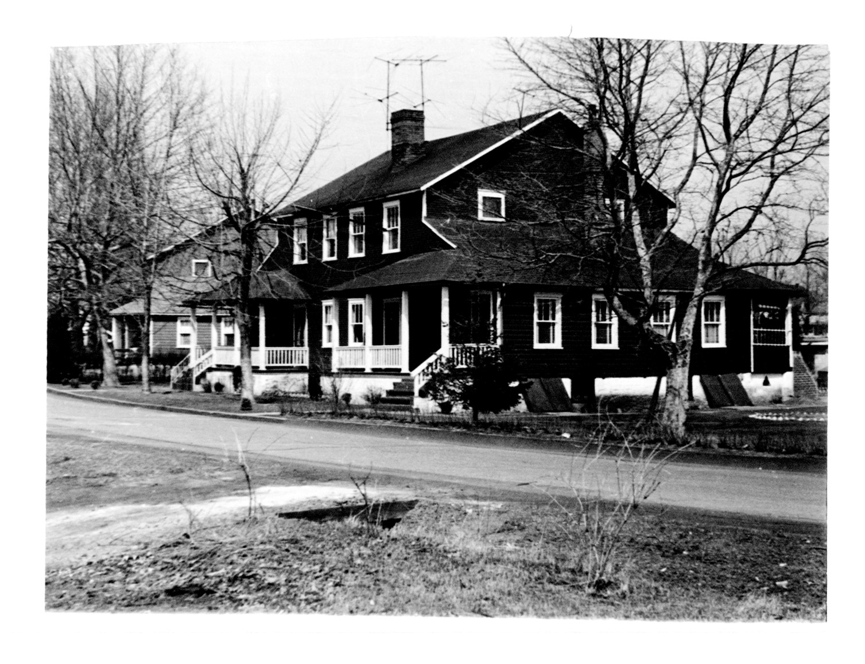
Coal Patch Towns
D
4 Family Square
United #1

Slide 8
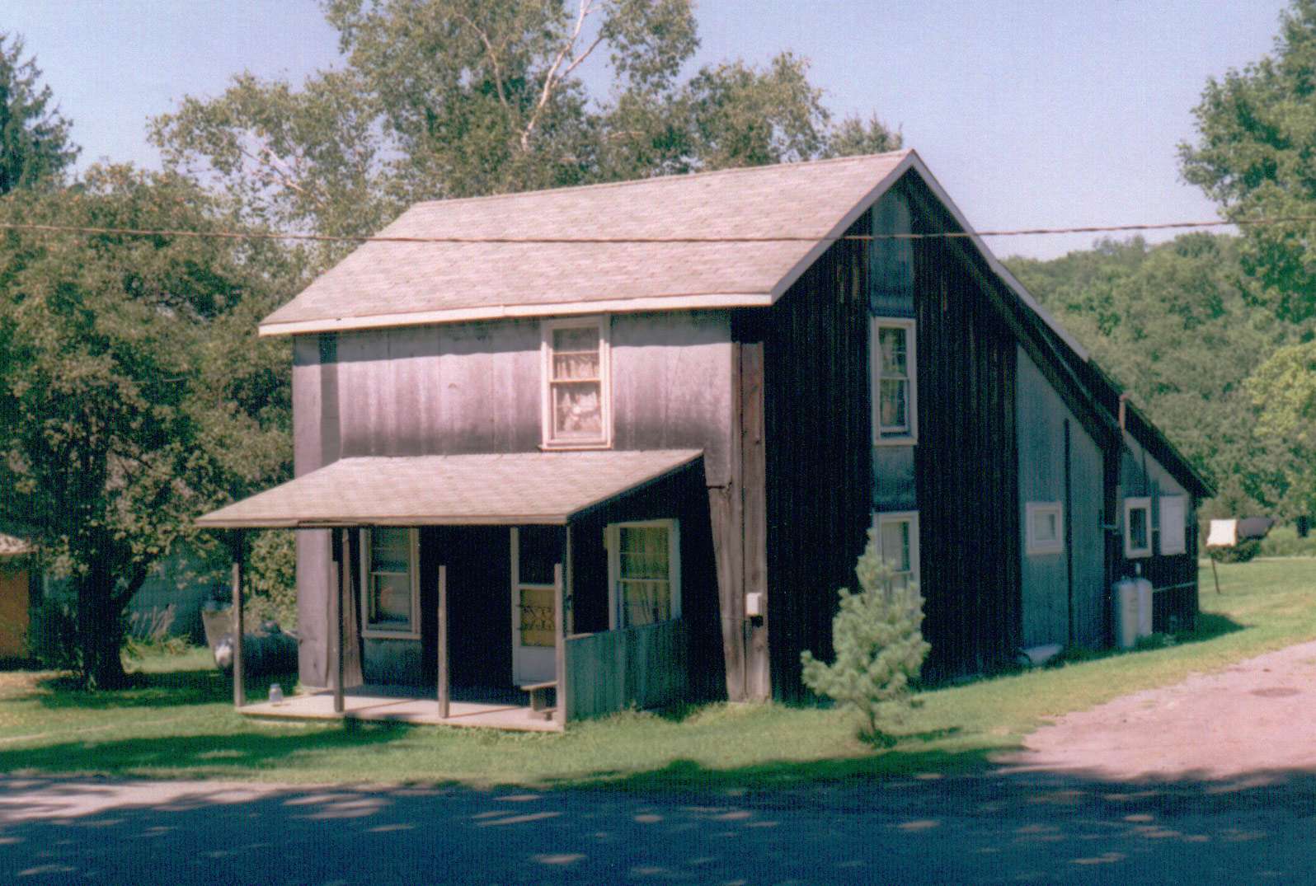
Coal Patch Towns
S
“J” House
Antrim

Slide 9
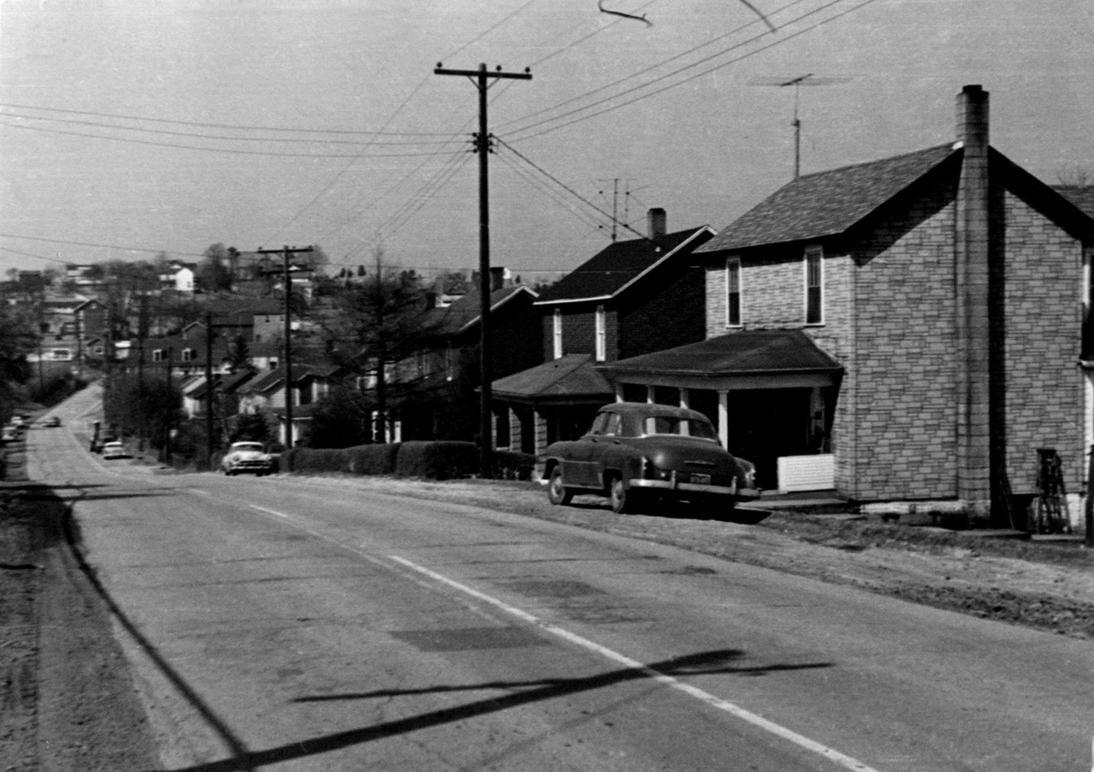
Coal Patch Towns
J
“J” House
Tarrs

Slide 10
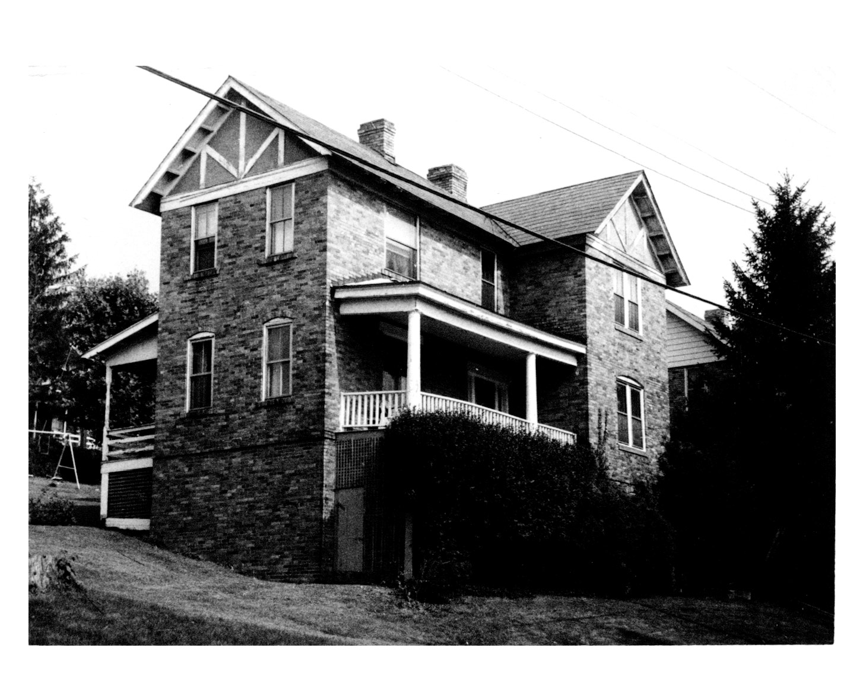
Coal Patch Towns
F
1 Family
6 Room Brick
Marianna

Slide 11
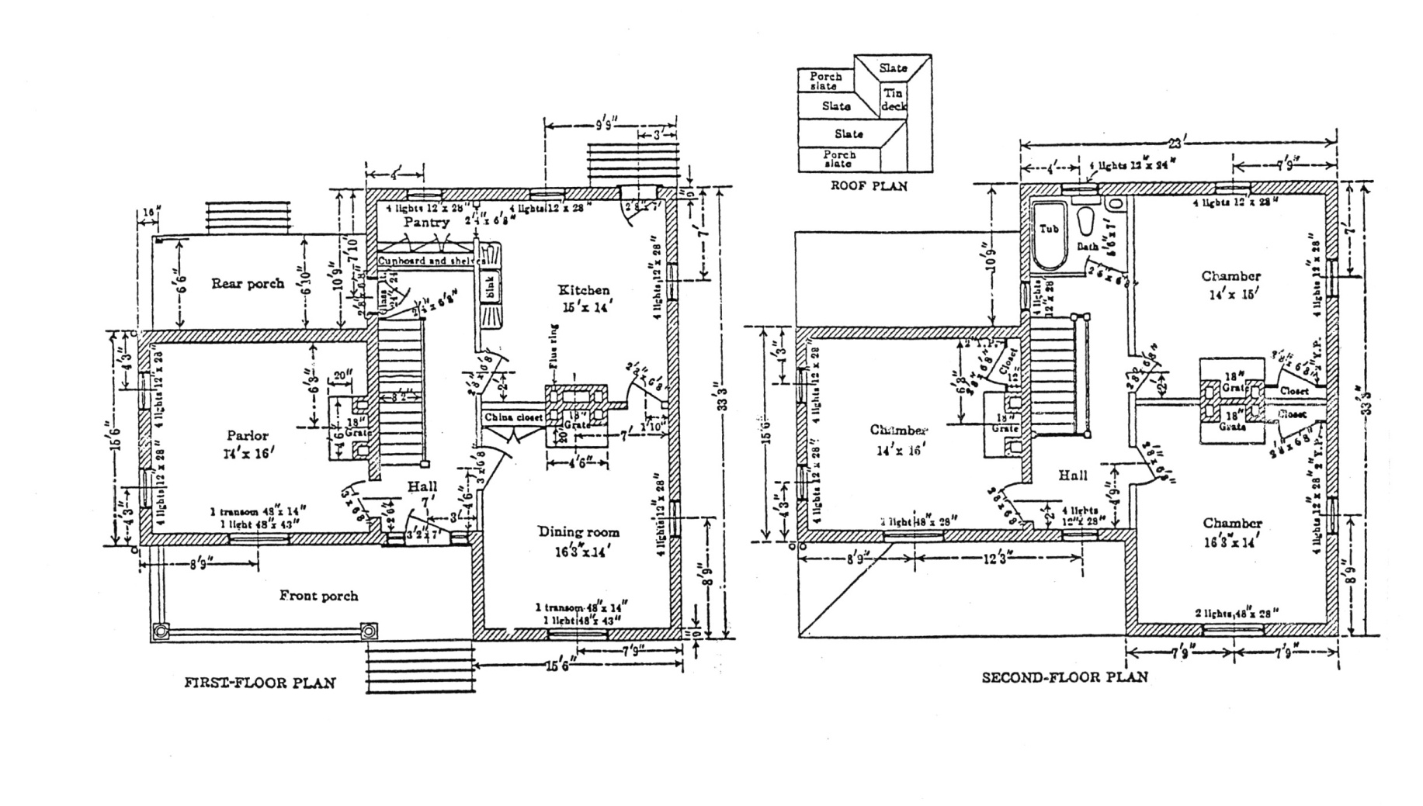
Coal Patch Towns
T
Floor Plan, 1 Family- 6 Room

Slide 12
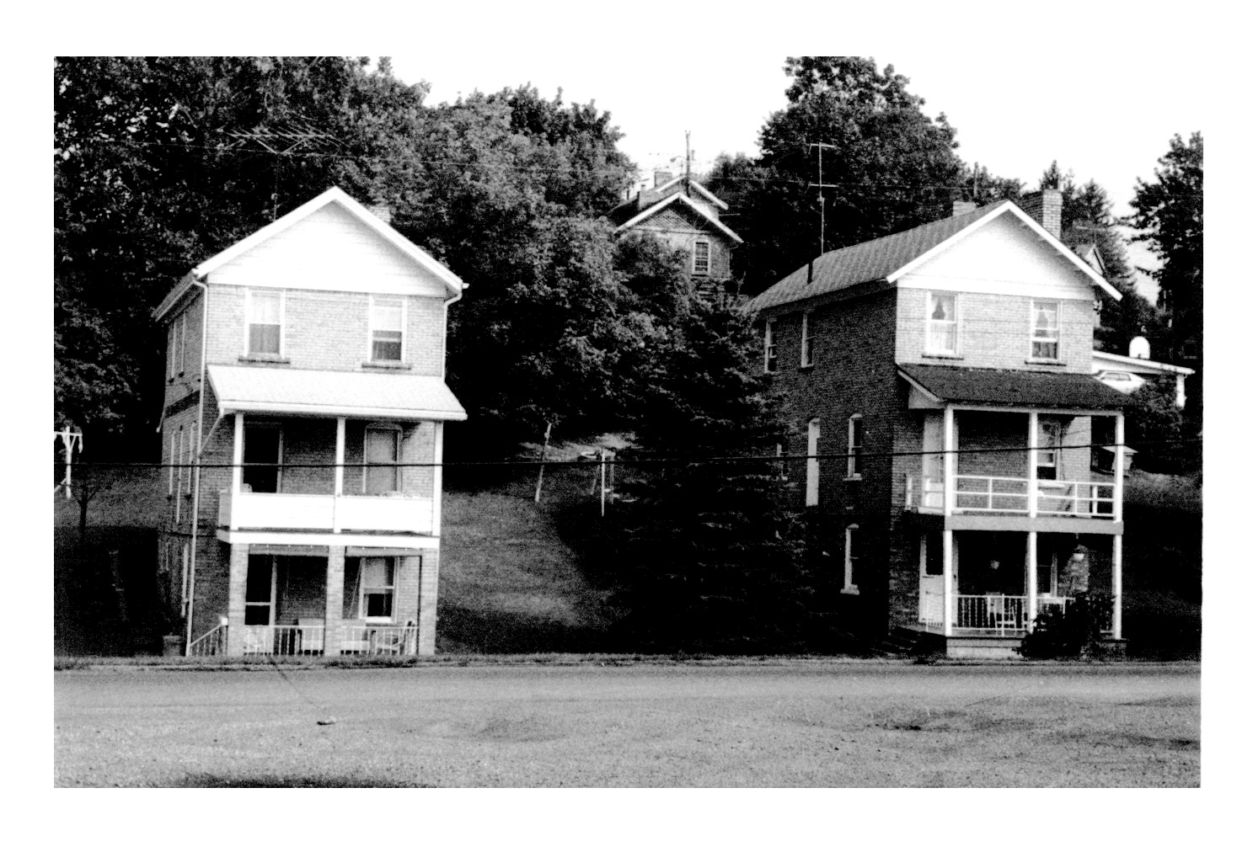
Coal Patch Towns
G
3 Story – 1 Family, Marianna

Slide 13
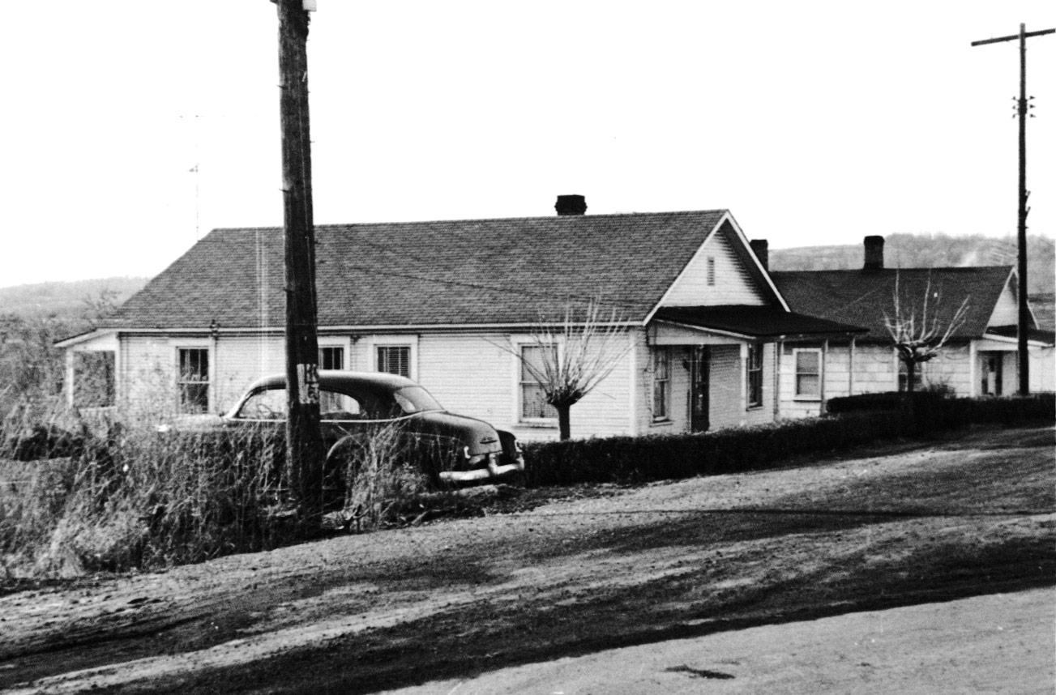
Coal Patch Towns
L
“Shotgun” House, Collier

Slide 14
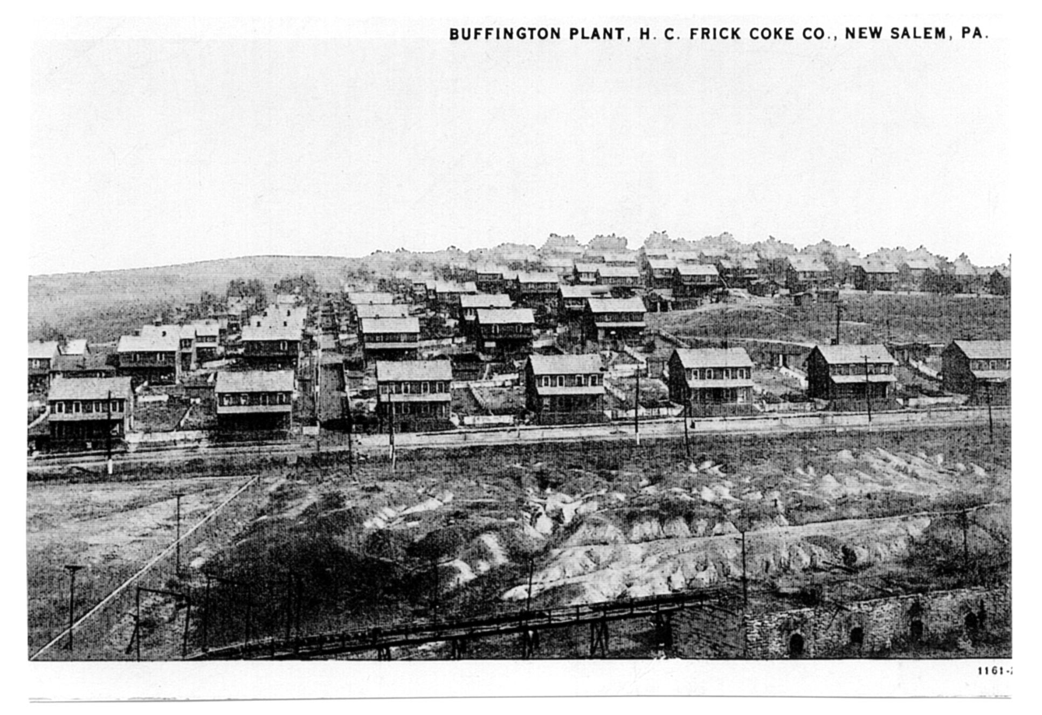
Coal Patch Towns
H
Patch of 2-Family Houses, Buffington

Slide 15
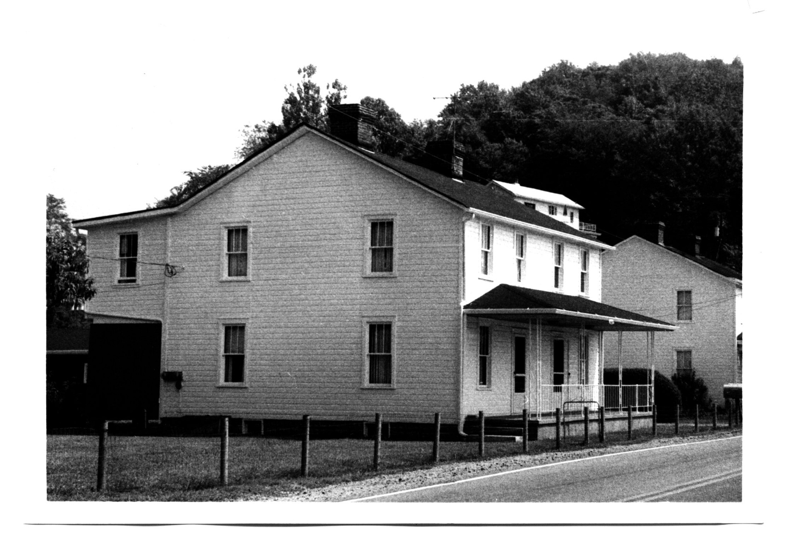
Coal Patch Towns
I
2 Story
2 Family
Westmoreland

Slide 16
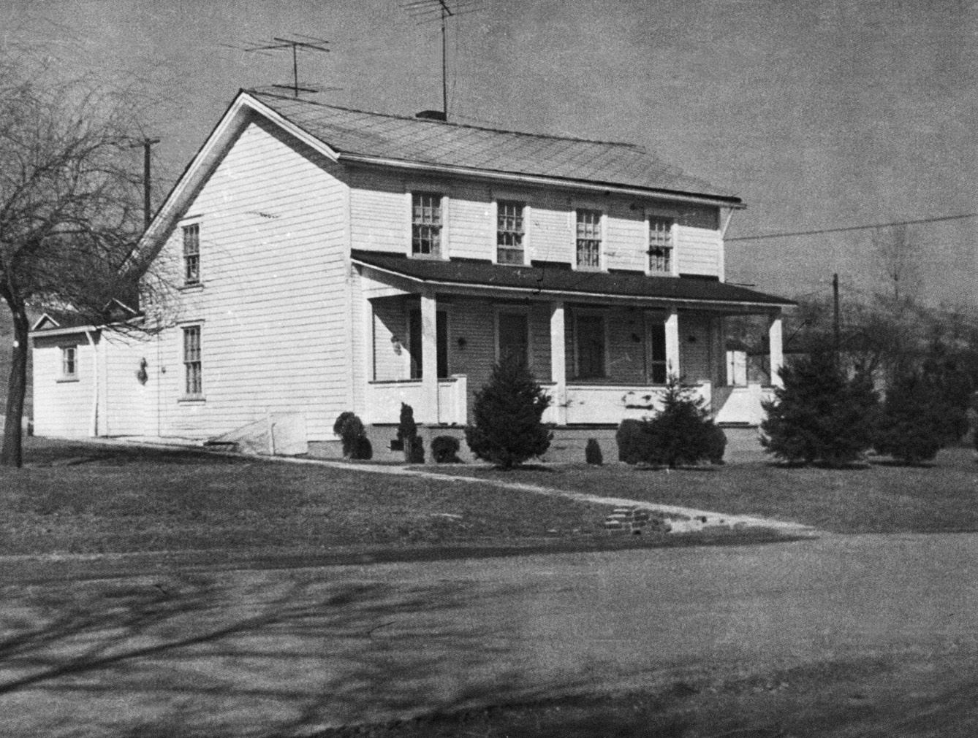
Coal Patch Towns
K
2 Family
“Saltbox”
Leisenring #1

Slide 17
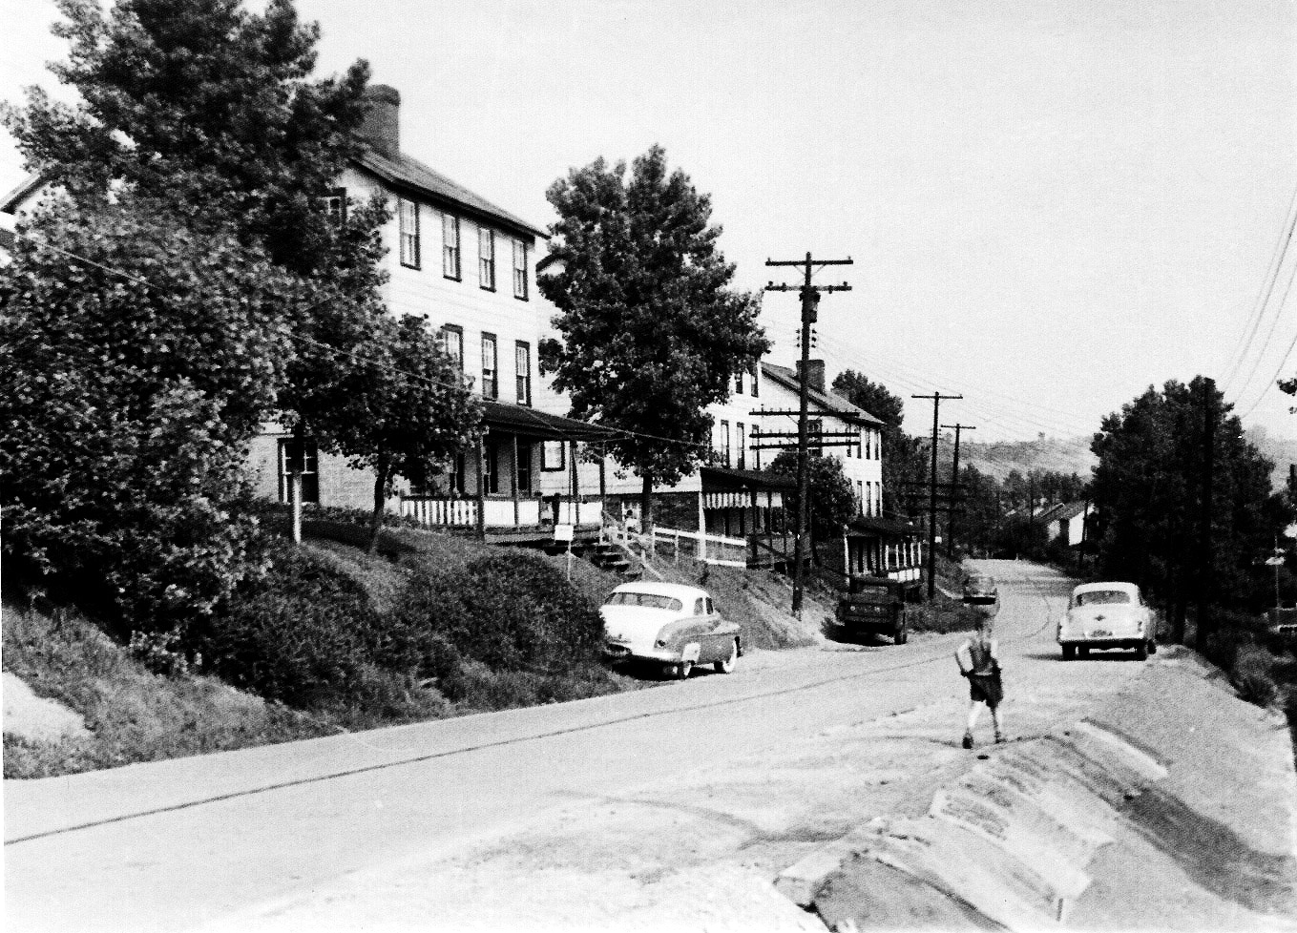
Coal Patch Towns
B
3 Story
2 Family
Isabella

Slide 18
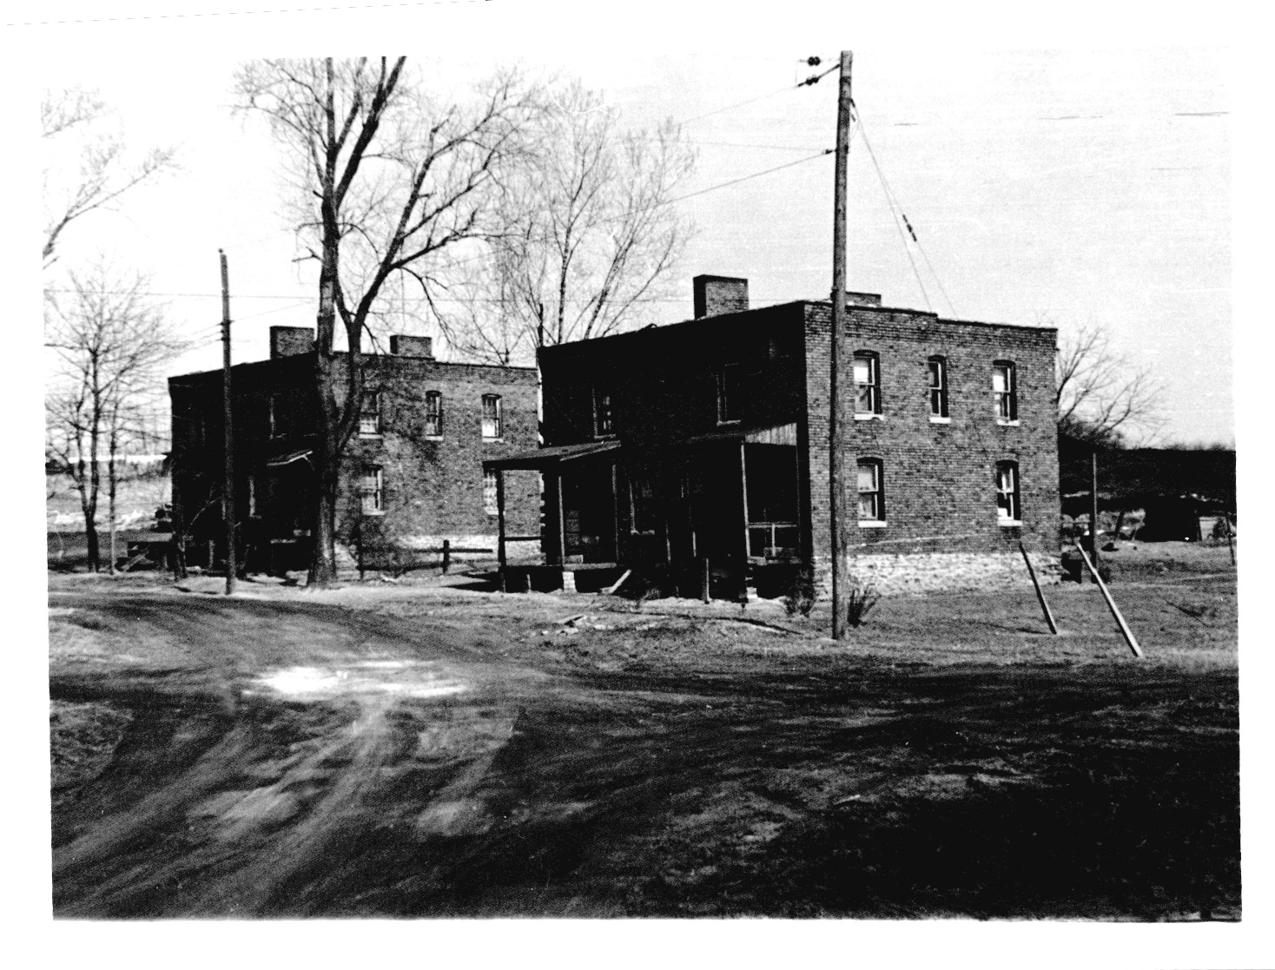
Coal Patch Towns
M
2 Story
2 Family Brick
Carpentertown

Slide 19
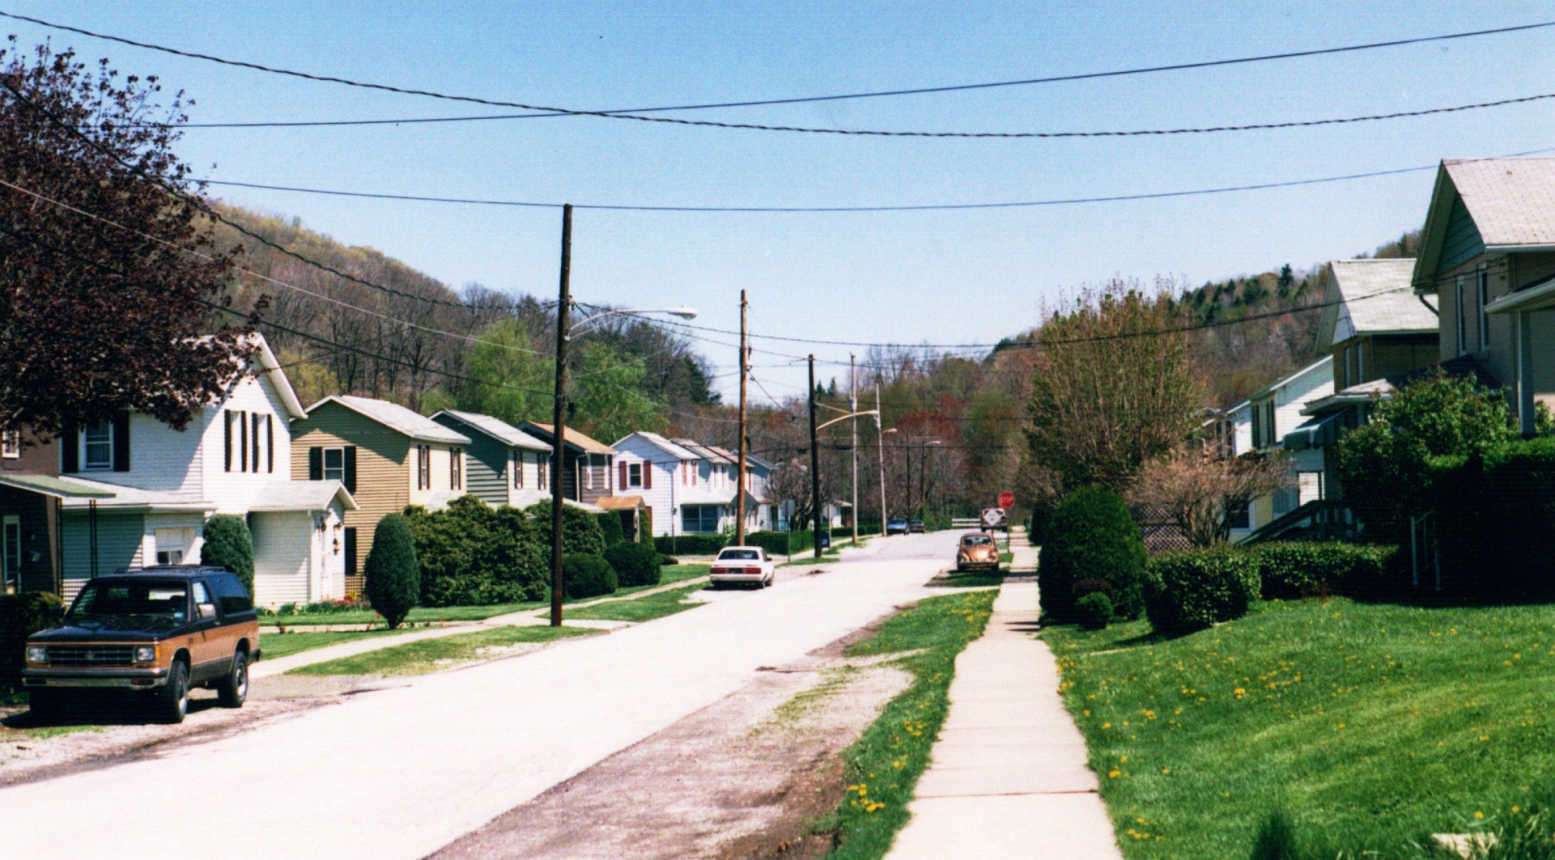
Coal Patch Towns
R
“Fire Space” Street, Clymer

Slide 20
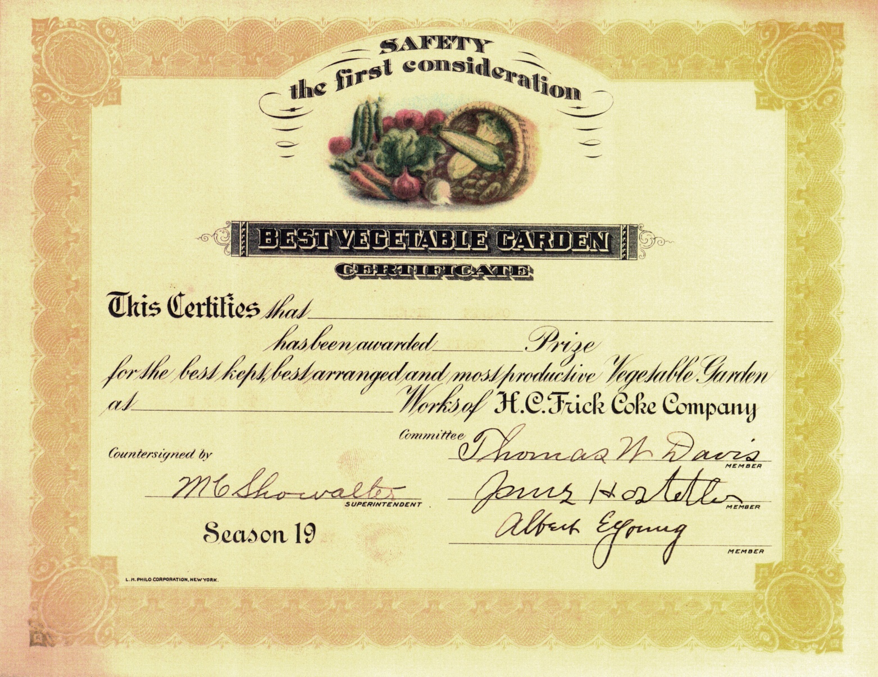
Coal Patch Towns
P
Frick
Vegetable Garden
Certificate

Slide 21
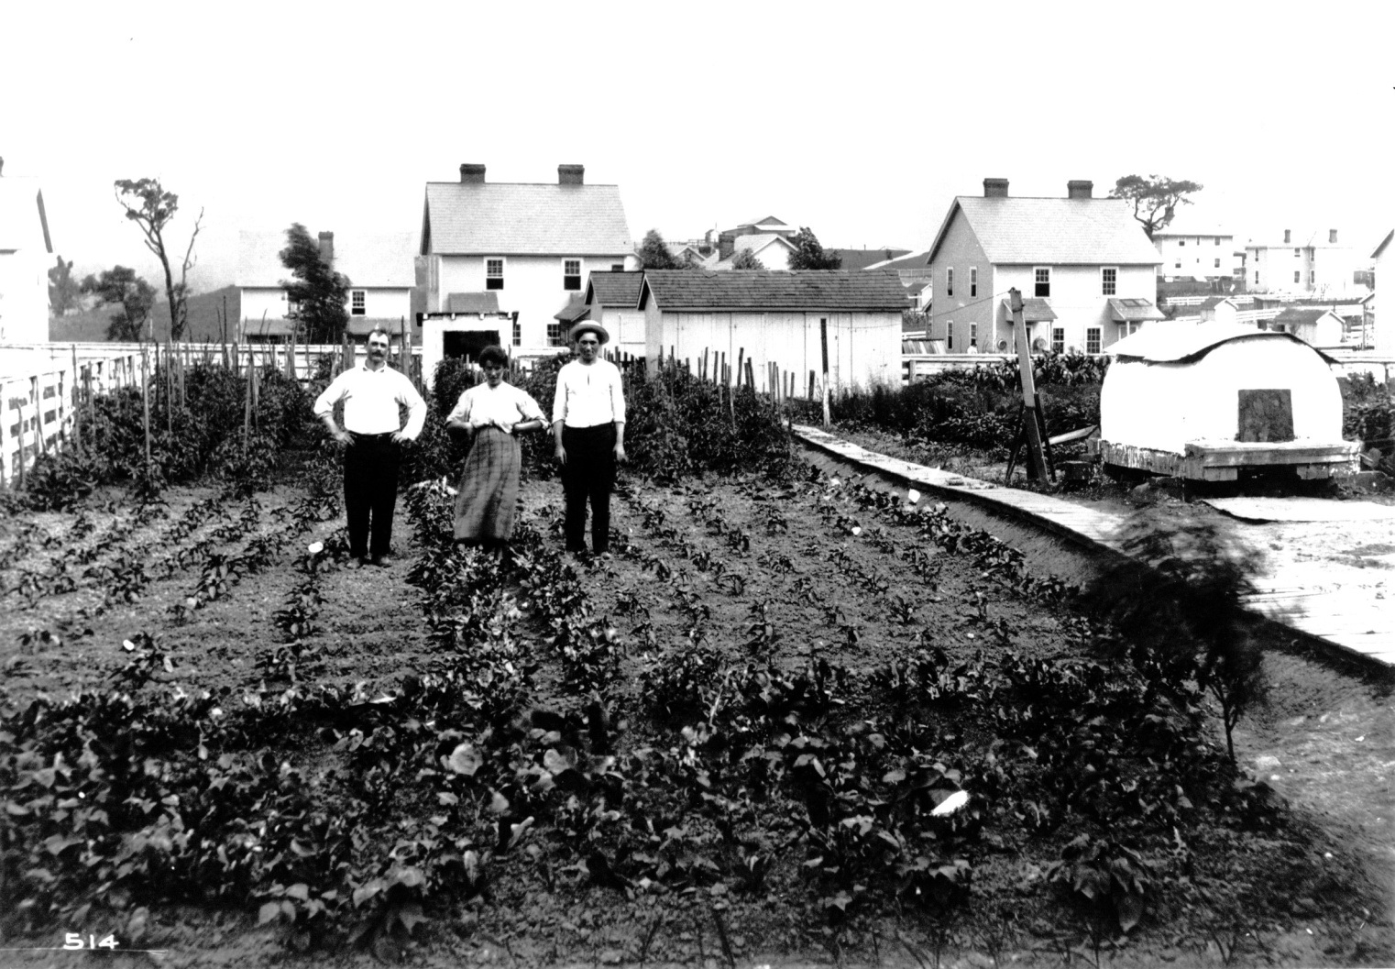
Coal Patch Towns
N
Garden, sidewalk, back oven, Phillips

Slide 22
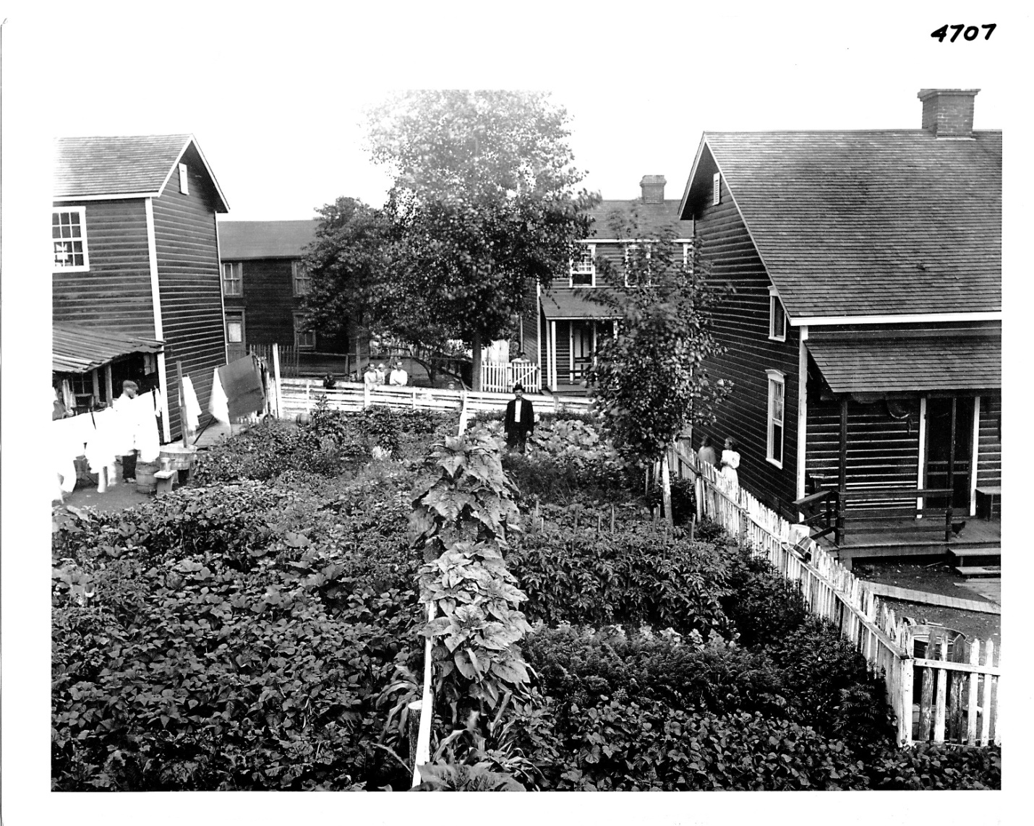
Coal Patch Towns
O
Adjoining
gardens
Standard

Slide 23
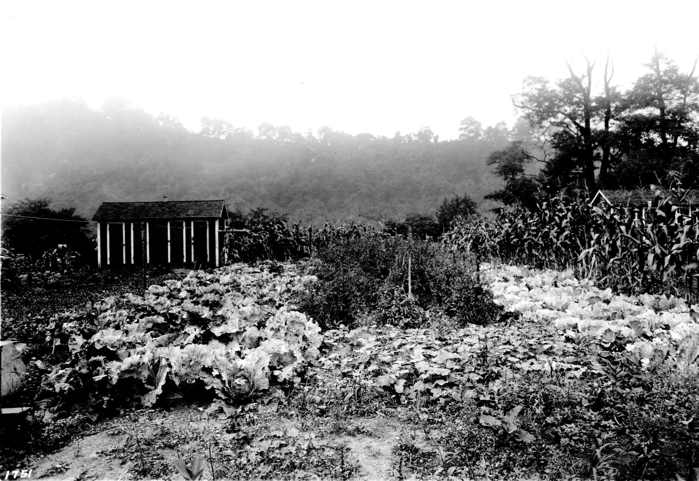
Coal Patch Towns
Q
Garden,
Coal bin / privy

Slide 24
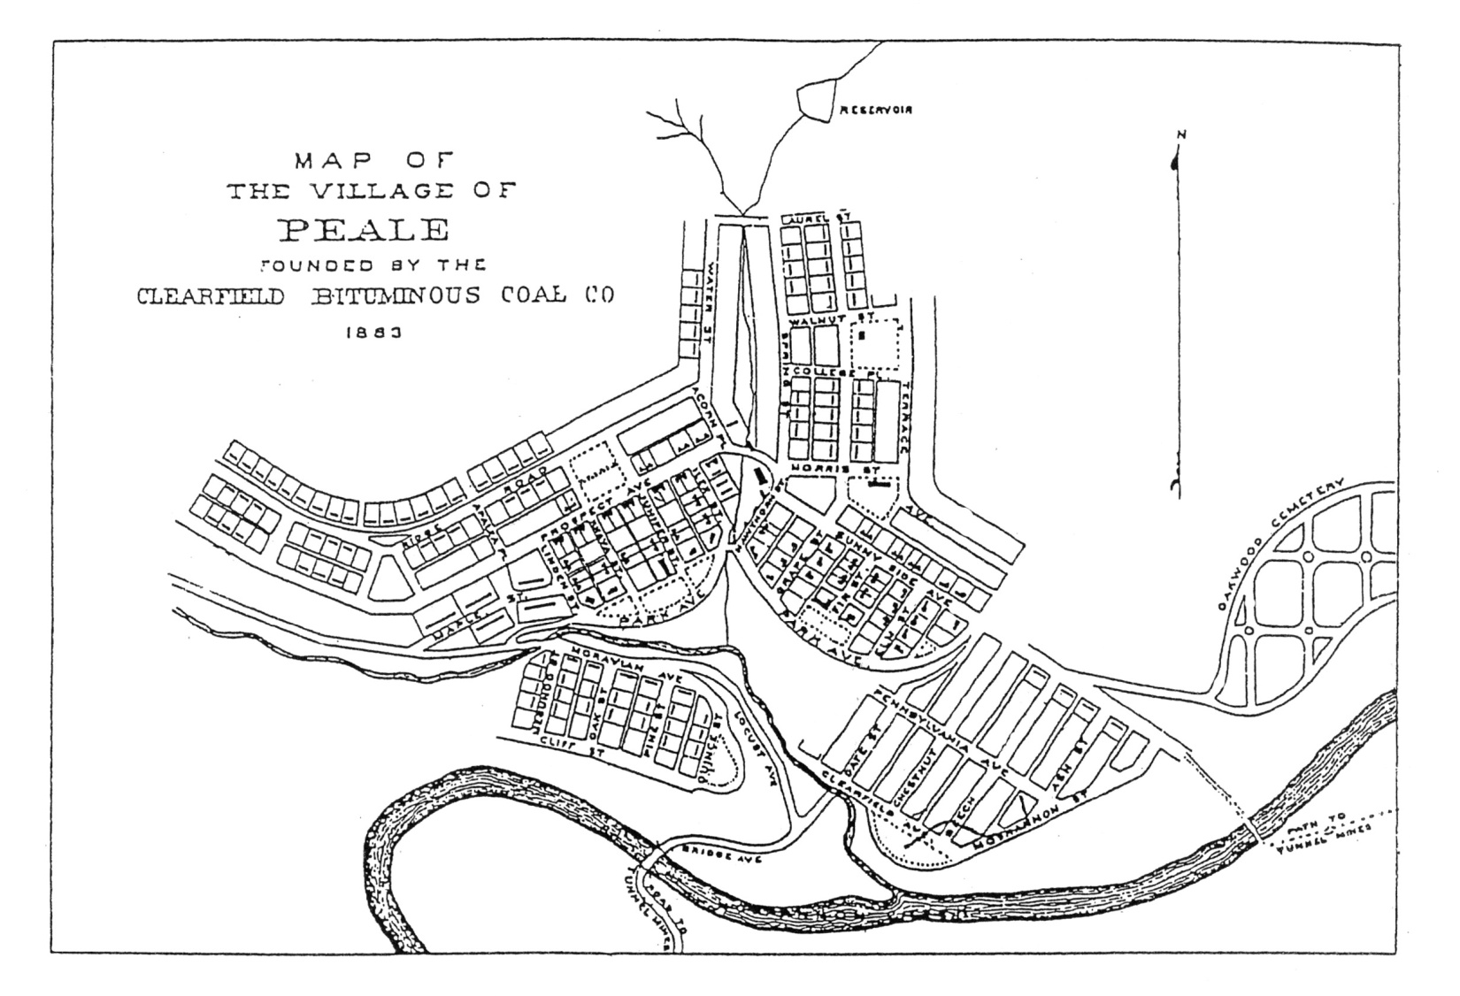
Coal Patch Towns
X

Slide 25
Coal Patch Towns
X
Questions ?

Slide 26
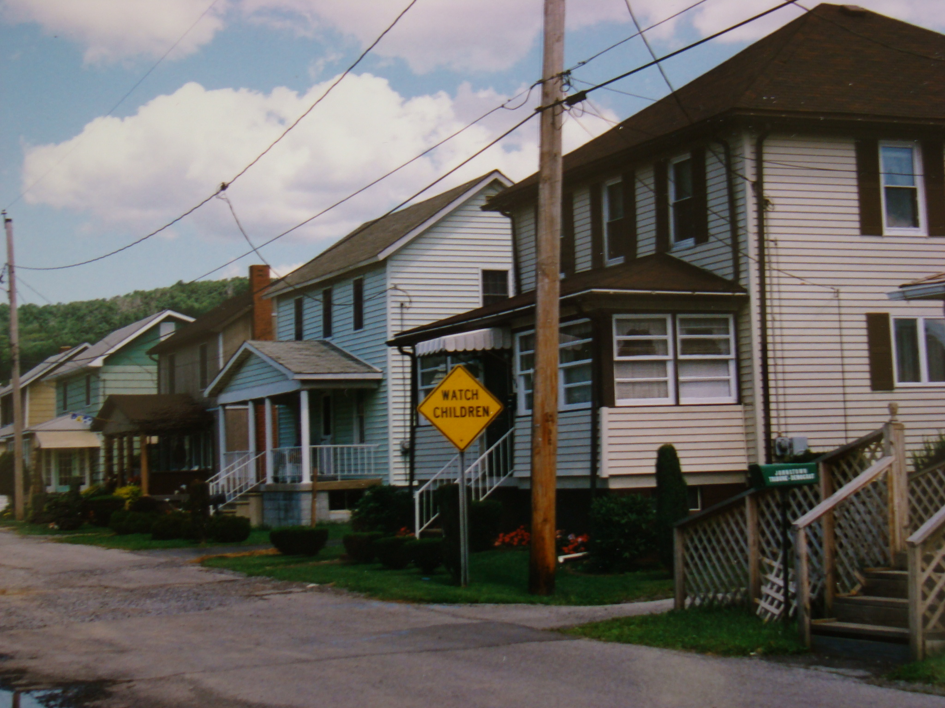
Coal Patch Towns
1

Slide 27
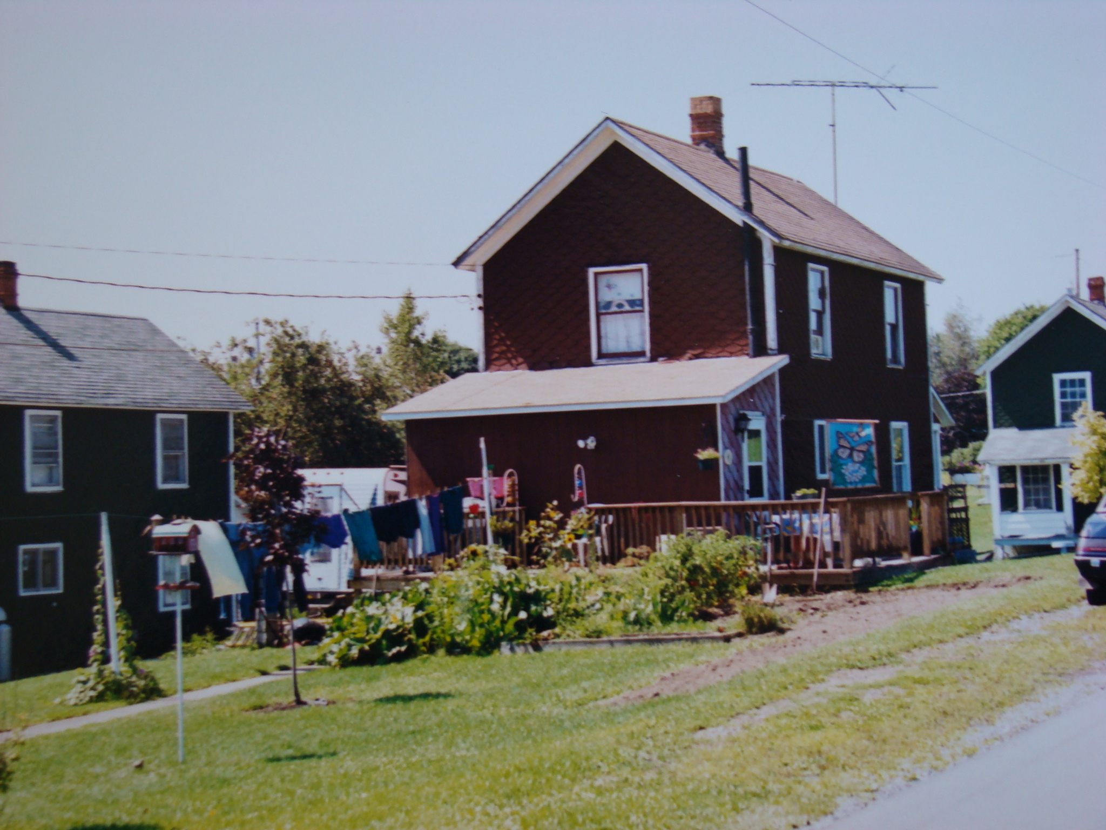
Coal Patch Towns
2

Slide 28
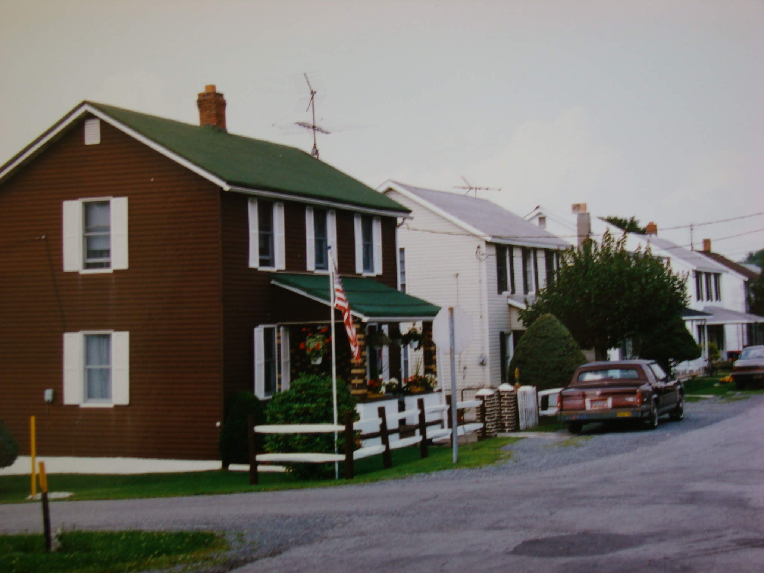
Coal Patch Towns
3

Slide 29
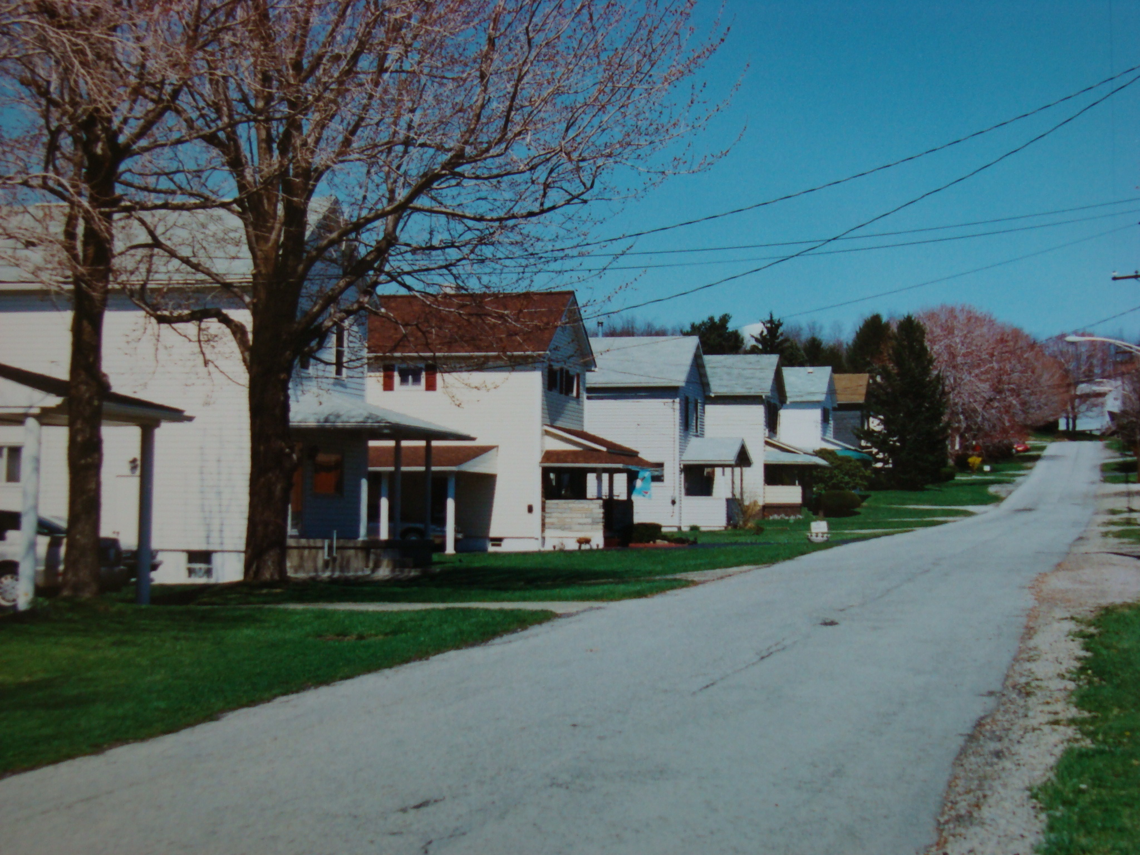
Coal Patch Towns
4

Slide 30
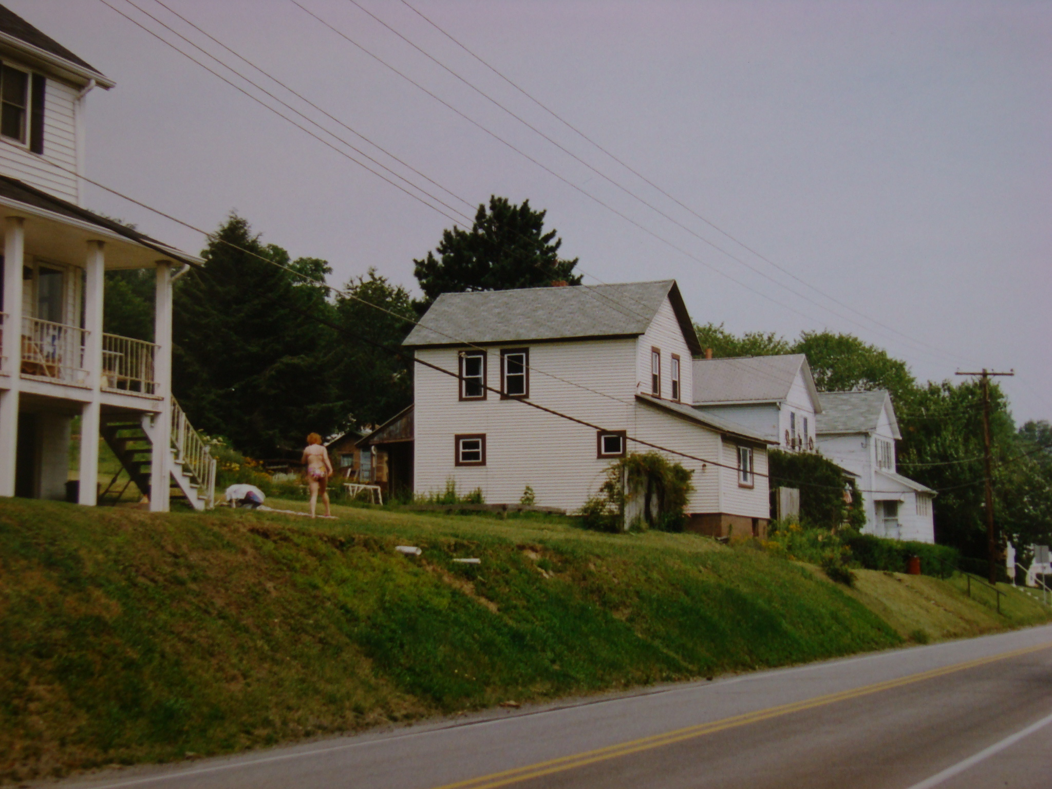
Coal Patch Towns
5

Slide 31
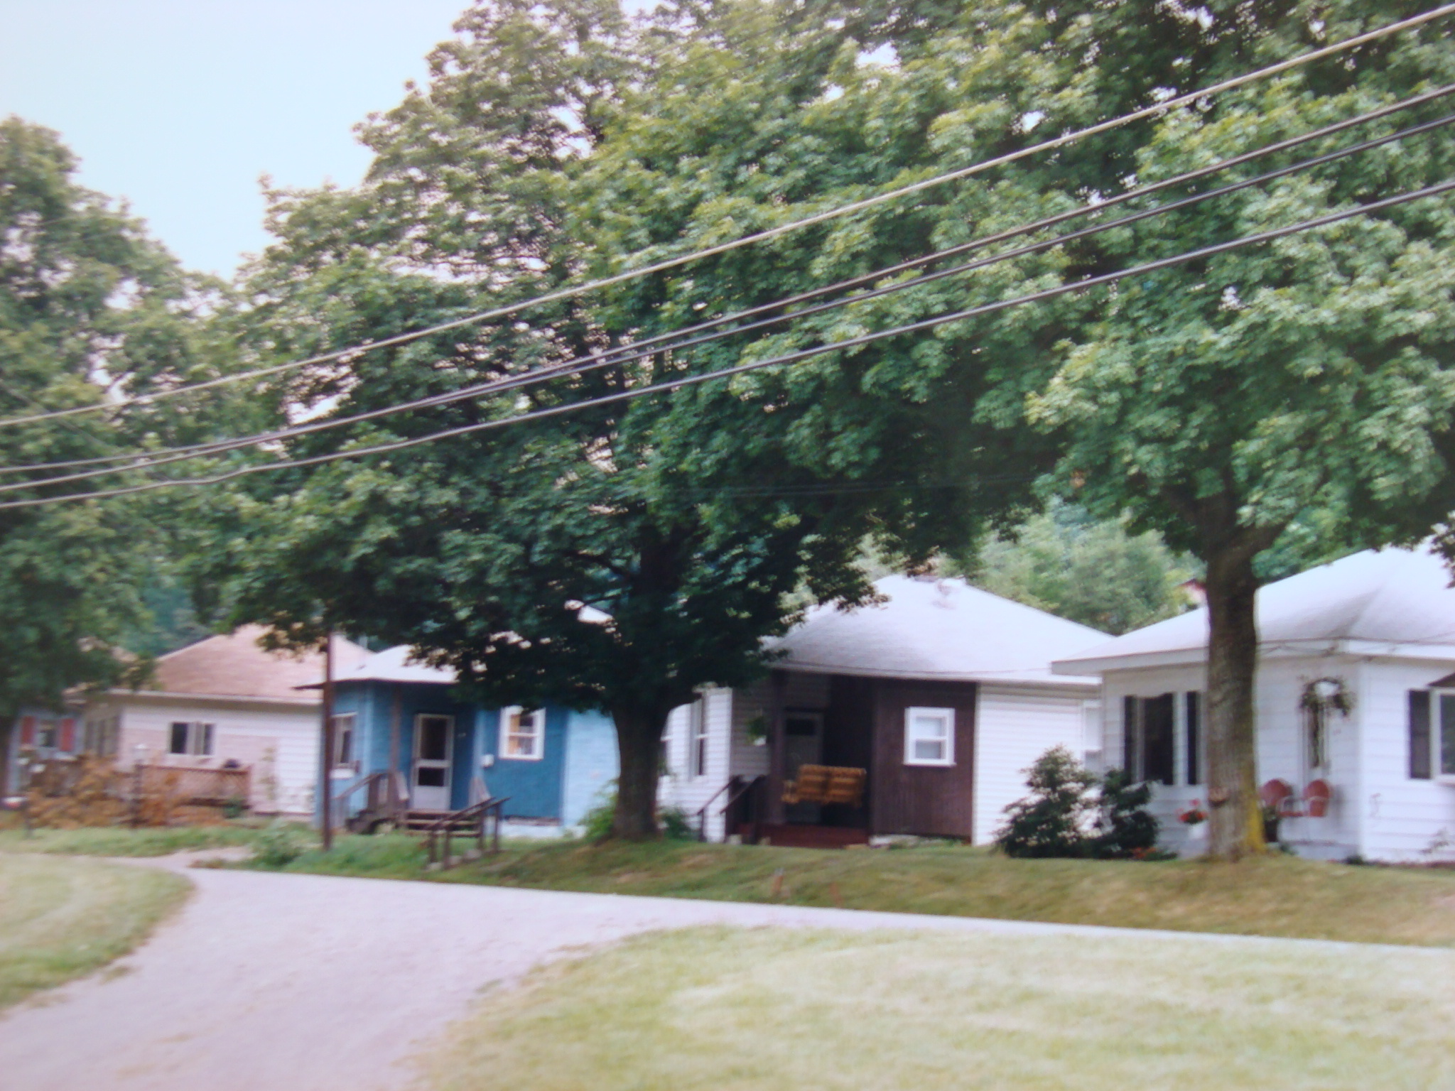
Coal Patch Towns
6

Slide 32
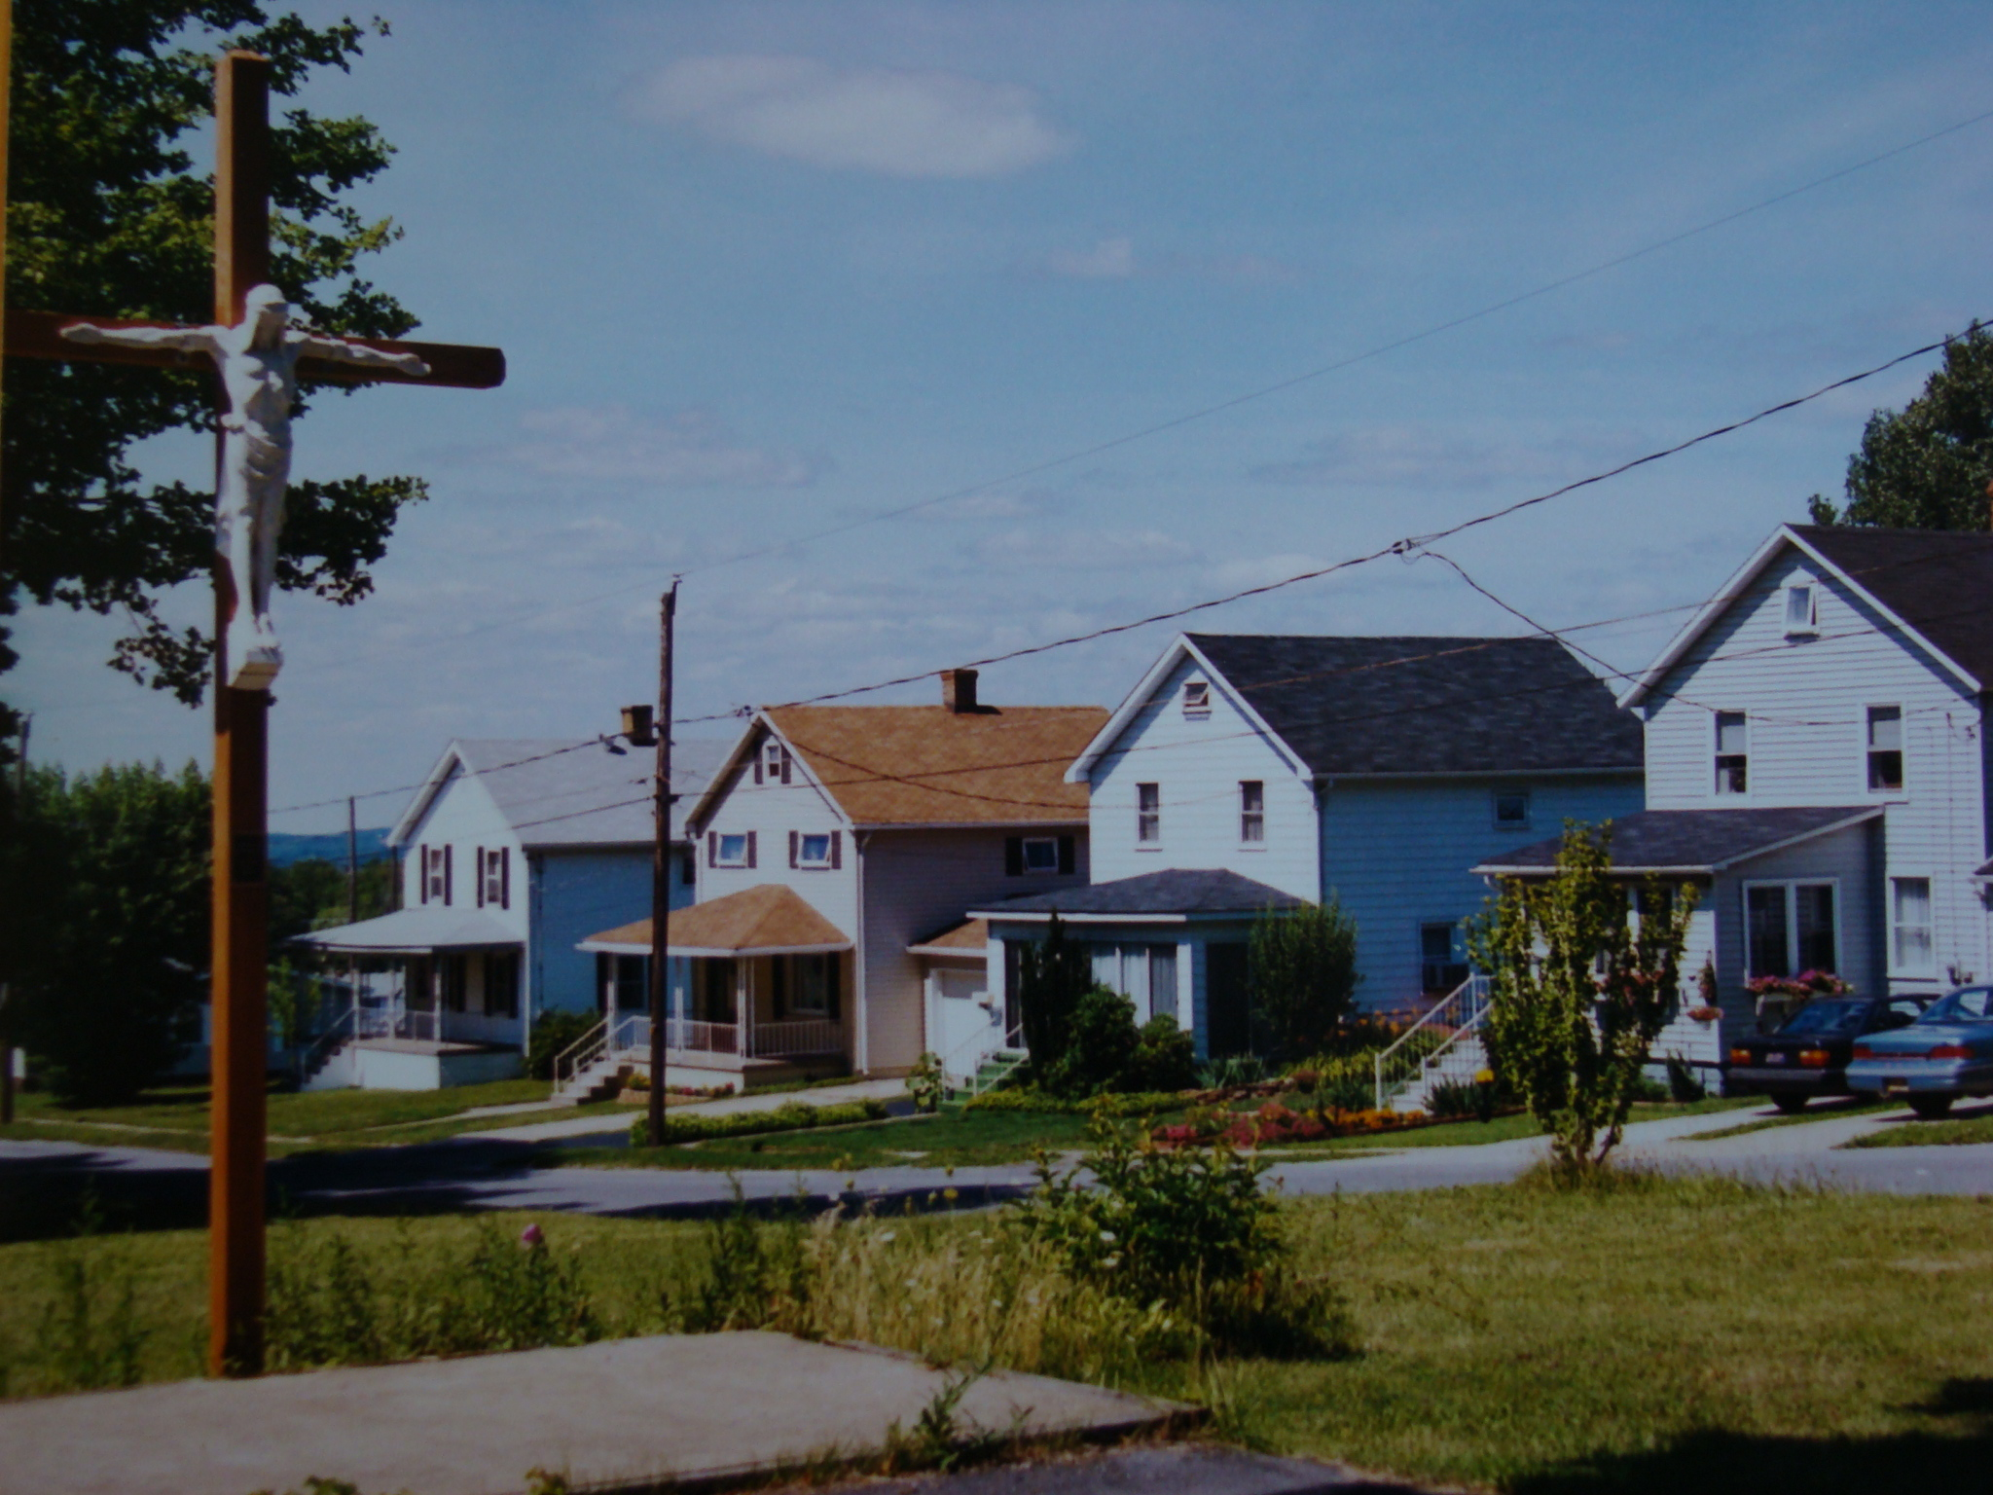
Coal Patch Towns
7

Slide 33
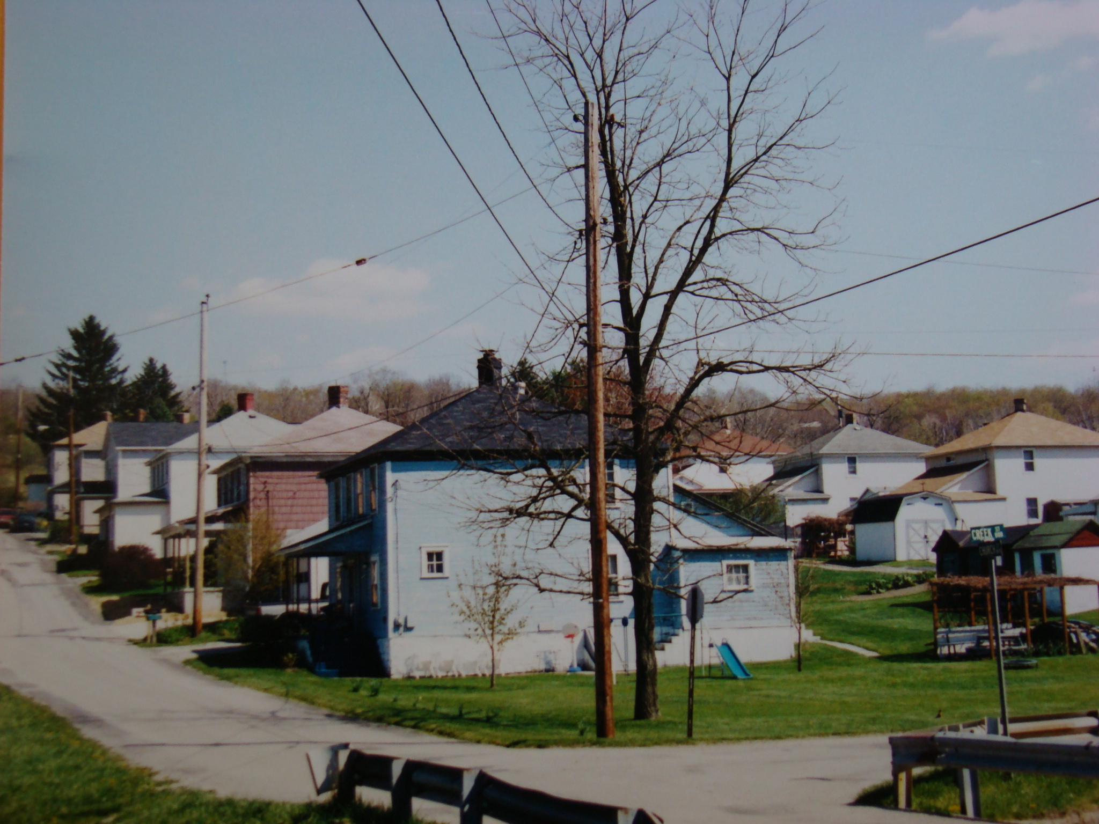
Coal Patch Towns
8

Slide 34
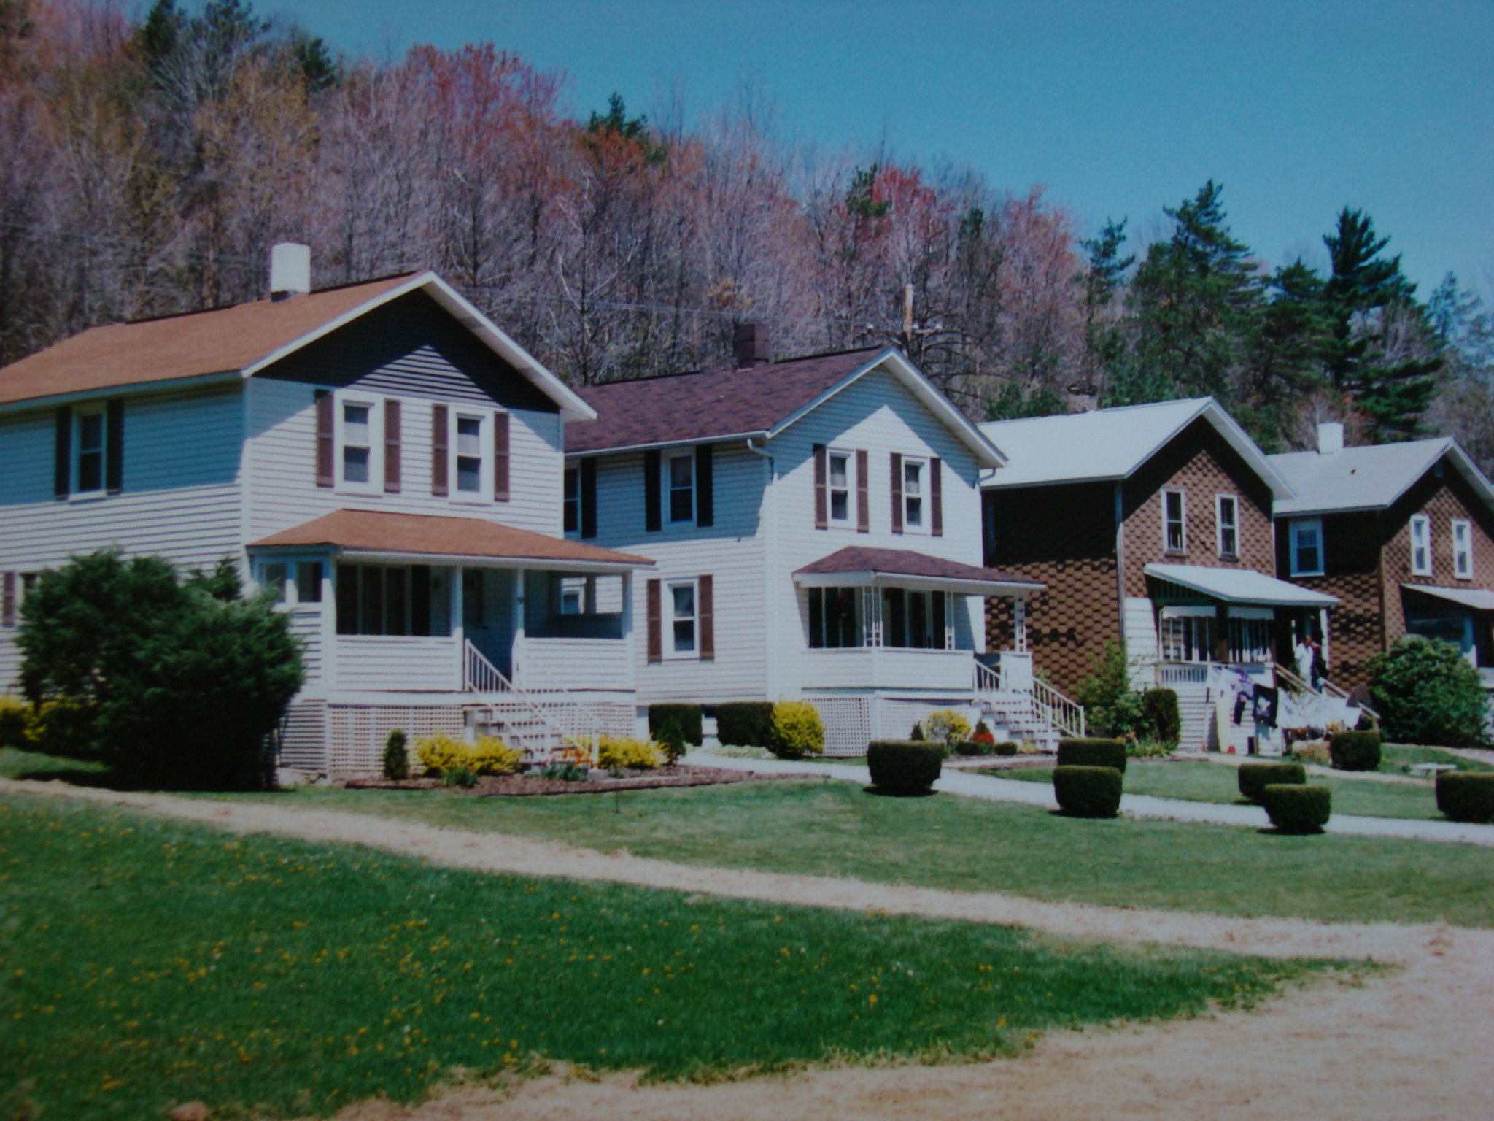
Coal Patch Towns
9

Slide 35
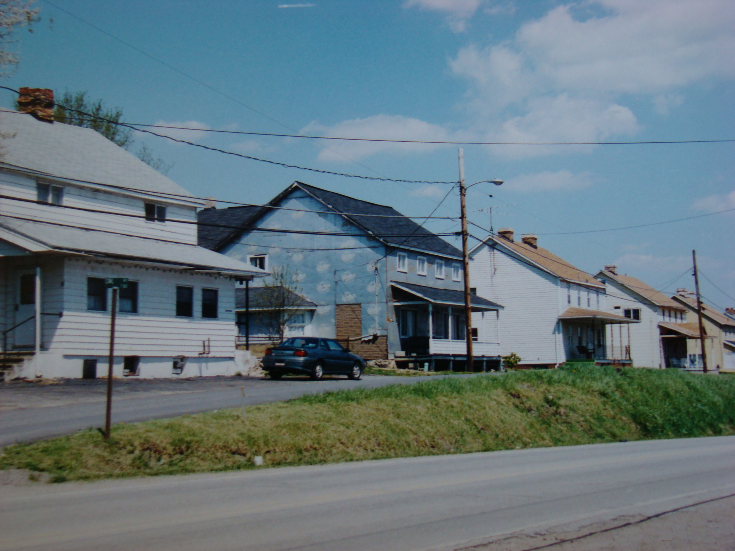
Coal Patch Towns
10

Slide 36
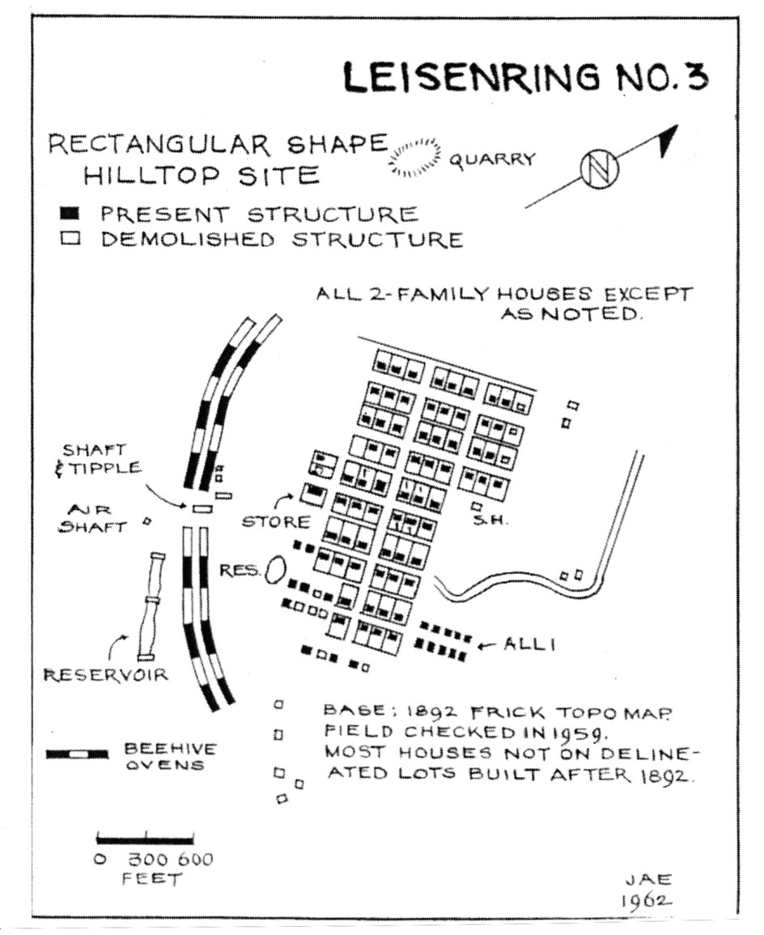
Coal Patch Towns
W

